Slide 2
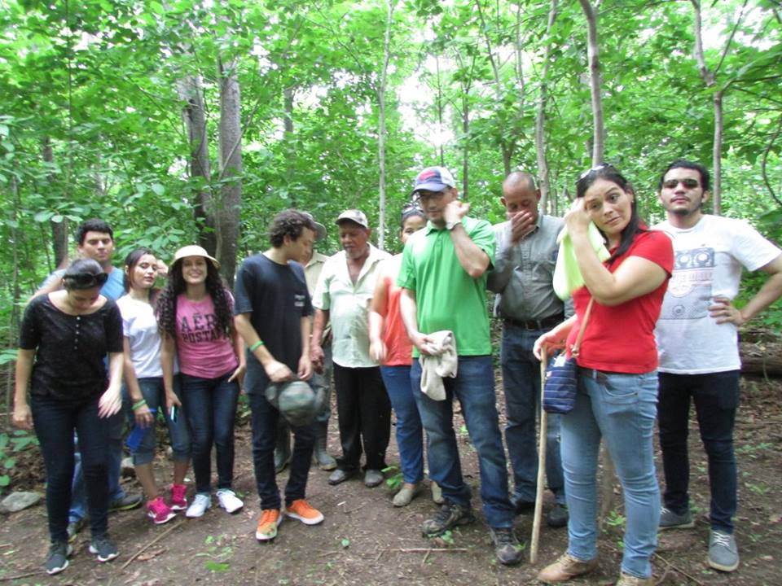
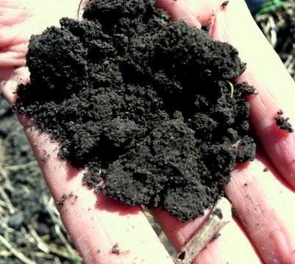
Mission:
The Feed the Planet Committee is responsible for three important roles within the World Chef community:
Sustainability education and projects
Education for employment for the disenfranchised
Local projects
In partnership with Electrolux and AIESEC

Slide 3
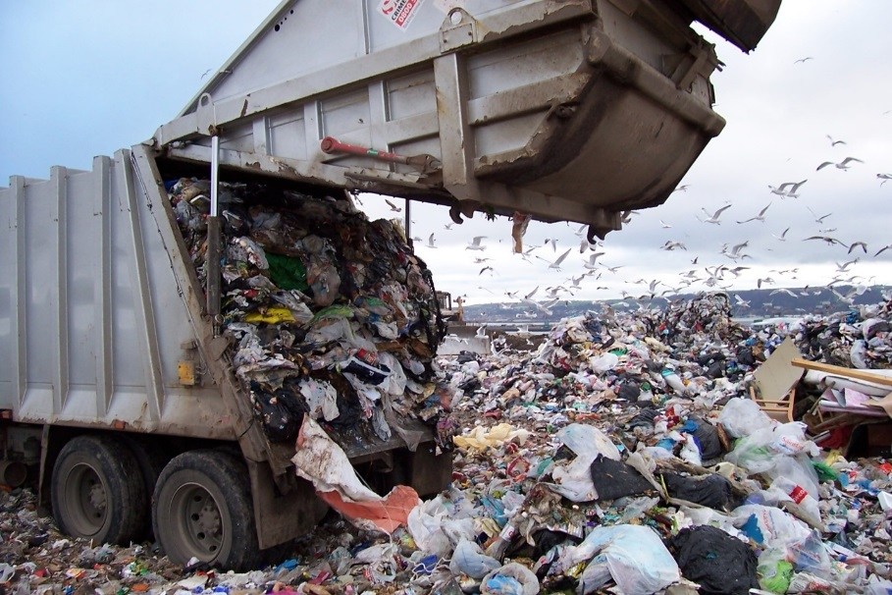
Sustainability and Chefs

Slide 4
Let’s Define Sustainability
The “capacity to meet the needs of the present without compromising the ability of future generations to met their own needs.”
-United Nations conference on environment and development
***********************************
Sustainability is ultimately about our future of our planet and life as we know it.
At the same time, it is about the decisions of the present—both large and small.
That is the problem. The effects of our decisions have a slow, but real impact, one way or the other.
Notes:
It is a good idea to ask the students for their definition before showing this slide.
Many people talk about sustainability frequently. It is important though to make sure that when we talk about sustainability that we all are on the same page. Another very important point is that it is about making decisions both large and small. Everyone has a role to play and it is the totality of many small and large decisions that determines how sustainable we are as a human race.
While talking about small decisions, get student feedback on the individual decisions that they face on a daily basis in terms of food, water, energy, and waste. Talk about the opinions that they have and what may prevent them from making sustainability-based decisions. This can include governmental, geographic, personal issues, and even a lack of knowing what to do or why.

Slide 5
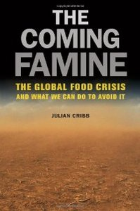
The Perfect Storm and The World Chef Challenge
The human race is effecting the planet at an unprecedented pace where between a rapidly increasing population with increased appetites for consumption and a finite and perhaps reducing ability to meet these needs—unless things change.
"Solving this crisis is the greatest challenge faced by humanity in the last 10,000 years”
Author, Julian Cribb, Ph.D., The Coming Famine
Notes:
It is highly recommended to read this book before teaching this class. It very completely describes the big problem that faces our planet and our human species. The point here is that we as a species are headed into uncharted waters where we are changing the world at an unprecedented rate. The solution will be difficult as negative forces have been put in motion and it will require us as a species to solve it—not a region, country, or city. At the same time, we all play a role in its solution.

Slide 6
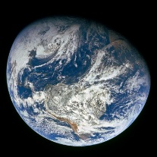
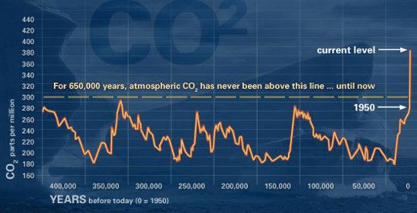
THE SUSTAINABILITY PROBLEM
Population Growth
Resource depletion and eventually scarcity of resources
Increase of consumption
Climate Change
Huge nutritional disparity issues
Notes:
It may be helpful to research the population trends in your part of the world and compare it to other parts of the world. Start asking the students for their feedback as to why this is happening (the answer is in 2 slides, but it will get them thinking).
Aside from the 2050 forecast is 9.3 billion people, some estimates see the global population rising to 10 billion in mid 2060s and 11 billion in 2090s. Yet the size of the planet is static and there are many concerns over providing for this growing population.

Slide 7
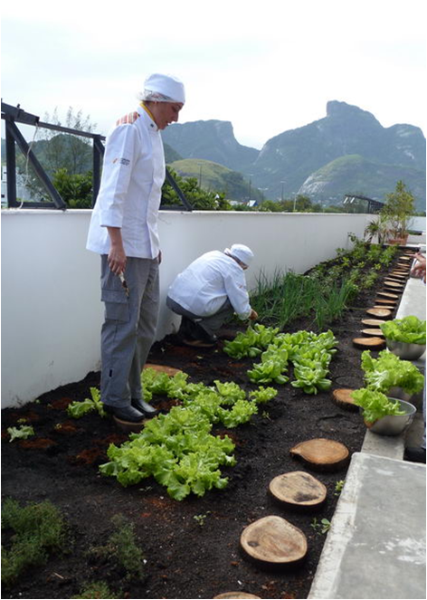
Sustainability and Foodservice
What we do in foodservice is all about
sustainability
We buy and cook a lot of food, often transported great distances
We buy large amounts of disposables
We use large amounts of energy
We use large amounts of water
We make large amounts of garbage
Sustainability makes good business sense as it can improve profitability and drive more customers who value sustainable businesses.
Notes:
This is a crucial transition slide where we move from the big picture problem to its intersection with foodservice. You may ask them how foodservice fits into this before you show them this slide.
Be sure that the students understand this slide as it points to our responsibility as an industry around the world to make sound sustainable decisions.
Do the students think that it is unfair that they need to focus on sustainability in addition to everything else that they need to know to be a competent chef?

Slide 8
Basic Sustainability Concepts
Sustainability is a journey that does not end and made up of mostly baby steps
No one is perfectly sustainable—there is always room for improvement and never a superiority complex
Education is key to changing behaviors. Education is on-going (more on this later)
As sustainability is a very diverse and complex, it is important to develop relationships with different experts
Notes:
These are concepts that will be repeated throughout the 7 class sessions. Spend time on each one.
The journey. Sustainability is most often made up of many small steps that individually seem inconsequential. But taken as a whole—the journey—they really add up. Thus, it is better to start with small steps than to wait for something big. Also, the journey does not end because the technology around sustainability is changing rapidly and we, as a species, are learning more about sustainability daily. This is also a humbling thought that keeps us grounded.
No one is ever perfectly sustainable. This is a not a game of one-up-man-ship. Rather, it is about us all working together. Sustainability is a global problem that requires a global solution!
People change behavior when they know WHY they need to change. As such we need to not only educate our students, but also other professionals, investors, and customers. For instance, chefs need to choose the types of food that they cook with as the production of food uses the majority of resources compared to the actual cooking process. Thus, in addition to knowing how to cook food, chefs need to understand its actual production. The problem is that food production is complicated. As Mr. Cribb points out, “it will be very important for chefs to educate themselves – and maybe commission some R&D – on which farming systems are more or less sustainable than others. The answers are not always obvious. For example, grainfed beef uses heaps of water, but if it is rainfall that’s OK, as it replenishes. If it is groundwater, that is not OK unless the aquifer is closely monitored.” This also points out how all parts of sustainability are ultimately connected.
No one knows it all when it comes to sustainability as it is a very diverse topic. Thus, it is essential to make alliances with experts in food, energy, water, and waste. Try to find some in your community who can also come and speak to your class. It also provides a great way for you, the teacher, to learn more about the topic.

Slide 9
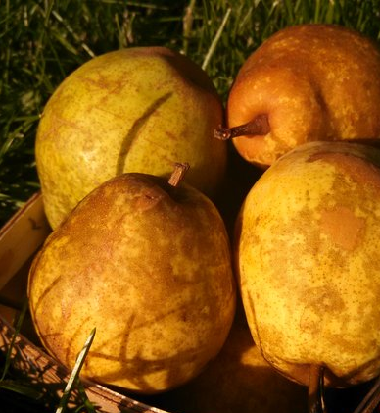
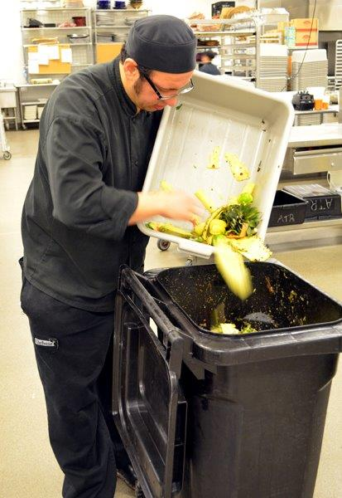
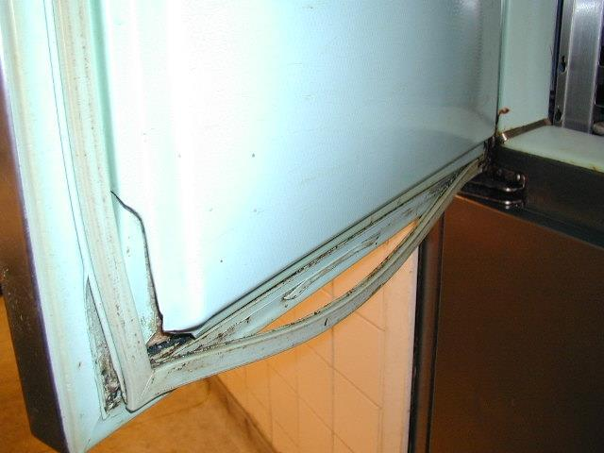
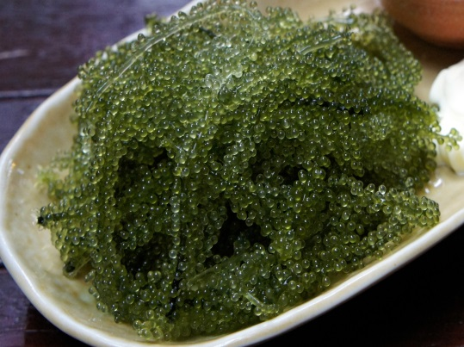
Cumulative Actions
Change is the culmination of many individual actions. Long term vs. short term thinking is required.

Slide 10
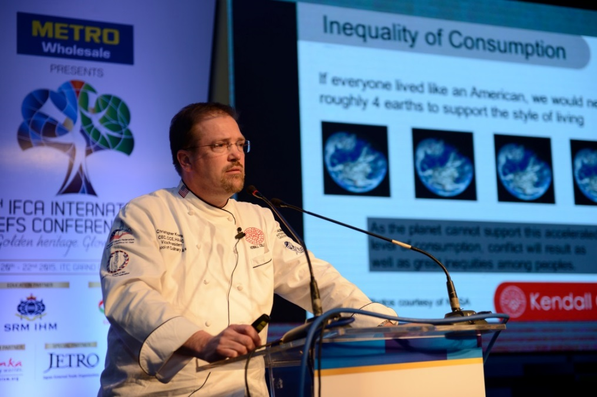
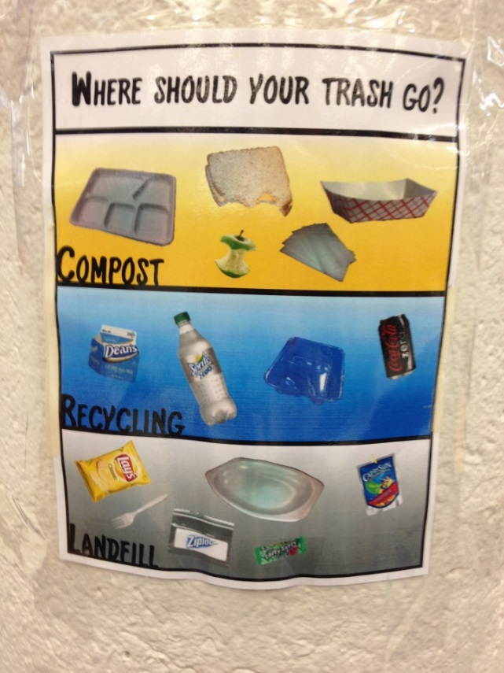
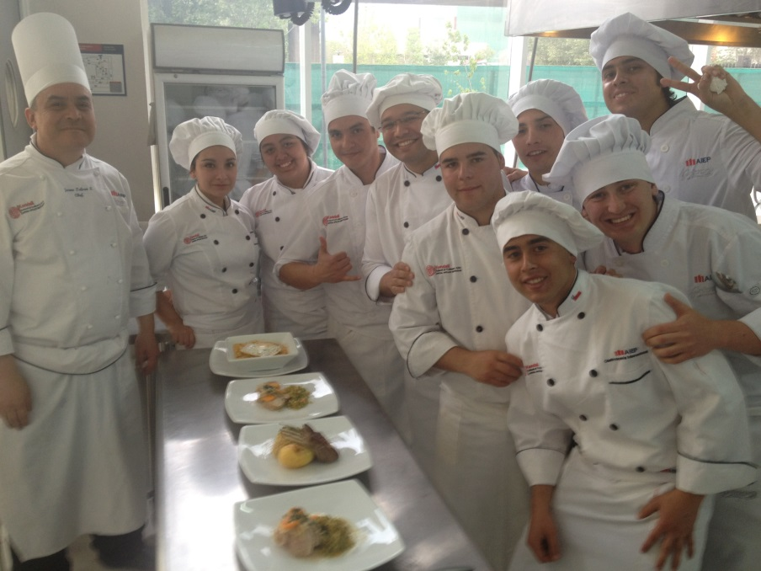
Importance of Education
Notes:
Sustainability curriculum
Sustainability clubs
School gardens
Local farmer partnerships
Aquaculture on campus
Composting and recycling
Bee keeping
Energy and water usage studies on campus
Waste audits
Studies in local cuisines
Increased focus on teaching low or no animal protein cuisine

Slide 11
Culinary Schools and Sustainability
Across the world, culinary schools are adopting sustainability as a core part of their curriculum.
It is critical that we teach it as it is the future.
Sustainability curriculum
Sustainability clubs
School gardens
Local farmer partnerships
Aquaculture on campus
Composting and recycling
Bee keeping
Energy and water usage studies on campus
Waste audits
Studies in local cuisines
Increased focus on teaching low or no animal protein cuisine
Notes:
This is a really important slide. What is critical is that students do not see sustainability as a topic that is separate from what they do everyday in the kitchen in the industry and at your school. The point is that sustainability is important to foodservice for many reasons and will only become more so as the future unfolds. We need to prepare our students for this reality!

Slide 12
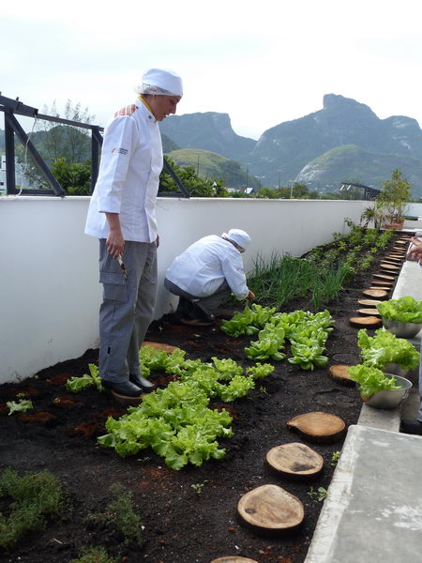
Worldchefs Sustainability Curriculum
Create a sustainability curriculum that is:
Not too in-depth, but enough material to matter
Globally relevant
For culinary education and chef education
Not too long, but long enough
Flexible
Customizable

Slide 13
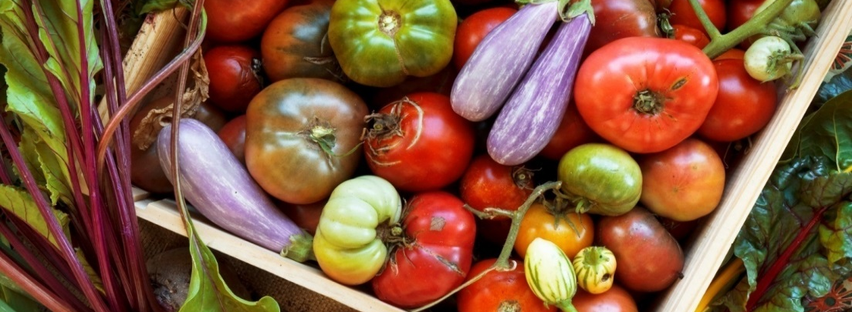
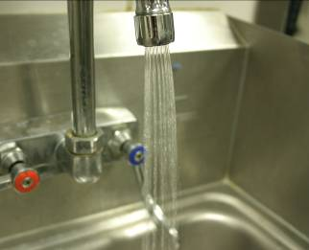
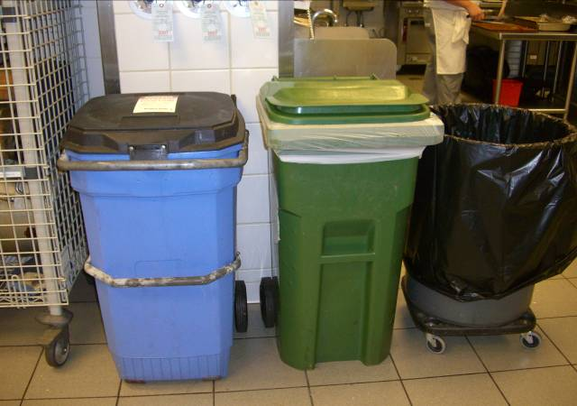
The Outline
Part I: Understanding the big picture
Part II: Agriculture—from the dirt
Part III: Agriculture—animals as food
Part IV: Seafood
Part V: Energy
Part VI: Water
Part VII: Waste
Notes:
Each part will be covered with 1 class. Encourage them to read up on each area before class. It would be ideal to give them additional websites for the next class that they may want to research (these will be provided in the materials for each class) as well as local articles, etc. that would be beneficial to the students.

Slide 14
The Curriculum 7 class days, each of 2-3 hours Designed to be flexible
Daily Materials:
Power point with many notes
Detailed lesson plan
Assignments and Quizzes
Additional resources
Activity ideas
How to bring it local
This can be flexibly be delivered over:
A course
A semester
A year
As part of chef meetings or events
Support is readily available for the instructor through:
In-depth and complete
notes
Webinar training sessions
Local geographical
customization
On-going support

Slide 15
Educational Design and a Tour
Regional
Local
The World
The
Individual
Foodservice

Slide 16
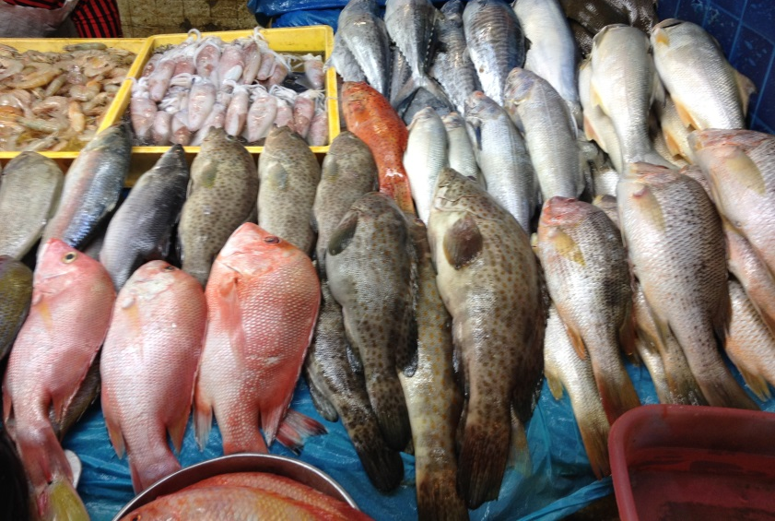
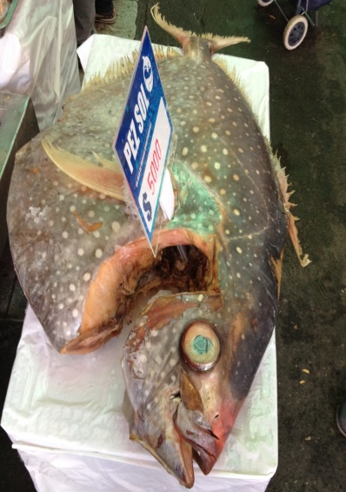
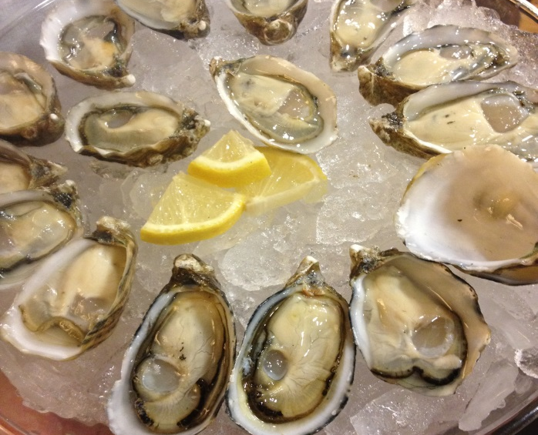
Los Mariscos y la industria de los alimentos
Comida de agua dulce y de los mares

Slide 17
What is the cost?
The entire Sustainability Curriculum is free to approved culinary schools around the world.
The only requirement is for organizers to complete a pre & post-test to document changes in learners’ behaviours on sustainability.
Our goal is simply to get it into the hands of as many students as possible around the world.

Slide 18
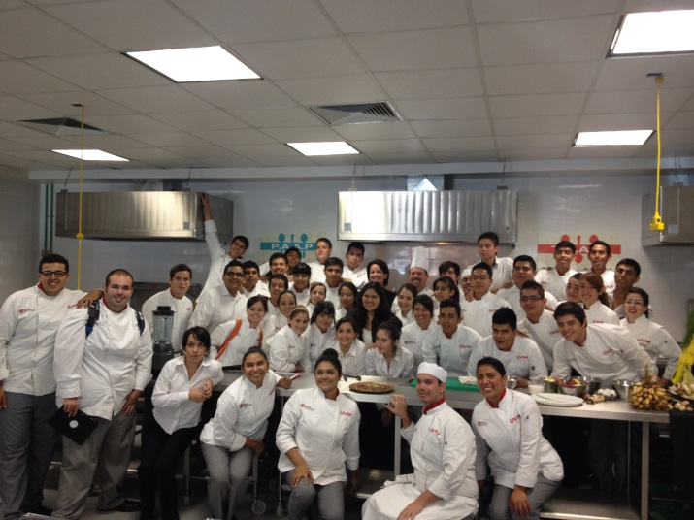
How do I register?
To find out more and become a course organizer, simply register at:
https://feedtheplanet.worldchefs.org/Sustainability
Following registration, a Worldchefs team member will connect with you within five business days to you get started!

