Slide 2
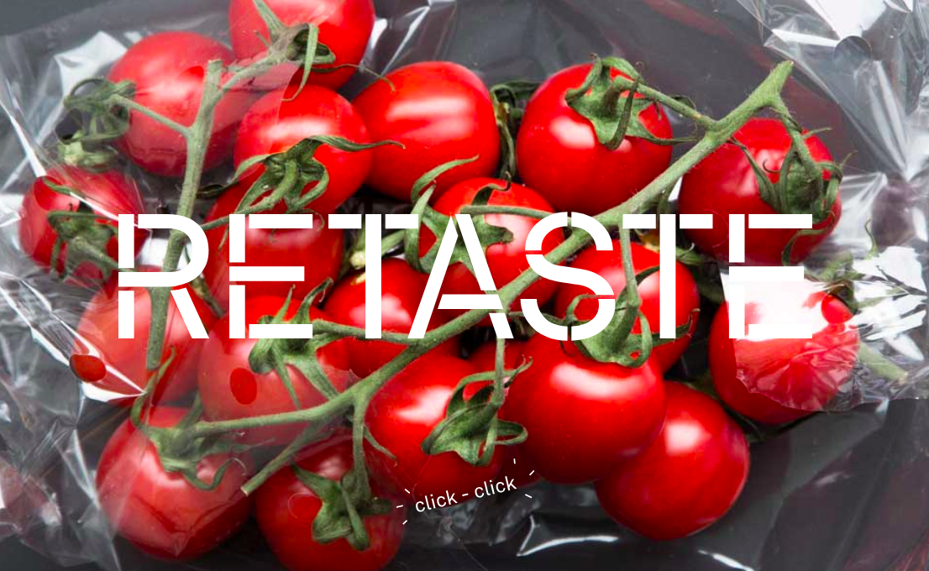
REIMAGINING THE FLAVOUR OF WASTE
RUTH OSBORNE + CHRISTOFER EKMAN
RETIRED HEN + PAULS KÖK
Notes:
Introduction
Thank you / Who we are / where we are from / The aims of our 20 minutes…

Slide 3
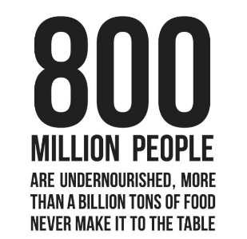

WHY?
Notes:
Why ReTaste? The issue of food waste.
SDG – Goal 2- Zero hunger.
QUANTITYS
1/3 of all food globally is wasted
NUMERICALLY IMPOSSIBLE TO GET YOUR HEAD AROUND THIS
MAJORITY WASTED
Fruit + veg, roots and tubers. Less food waste of meat and fish. They have less waste but produce more CO2
Rich countries waste as much food as produced across the WHOLE of Sub Saharan Africa – 222 / 230 million tons
WASTE PER CAPITA:
95 – 115 kg / person / year in Europe + Northern America
6 – 11kg / person / year in Sub Saharan Africa / South and South Eastern Asia
40% loss at post harvesting and processing in Sub saharan africa / asia
40% at retail and consumer point in North America / Europe

Slide 4
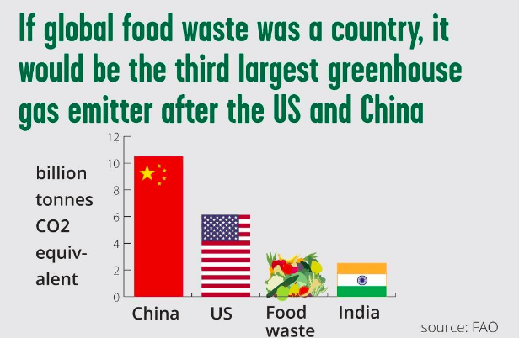
Notes:
LAND
All over the planet, land is used to produce food that we waste.
This land would form the 2nd largest country in the world…
Russia : Food waste : China
And be the third highest emitter of green house gases
China : USA : Food waste
EMMISIONS
Almost as high (87%) of global transport
This land would have the highest water use foot print:
Food waste: India : China
COST
Market value of lost / wasted food = $936 billion

Slide 5
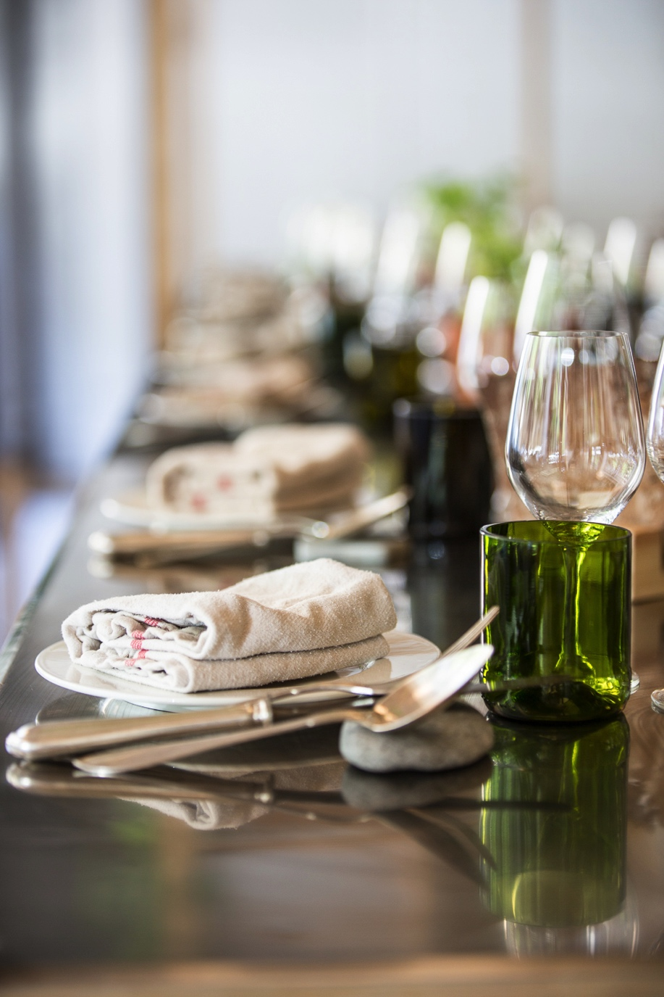
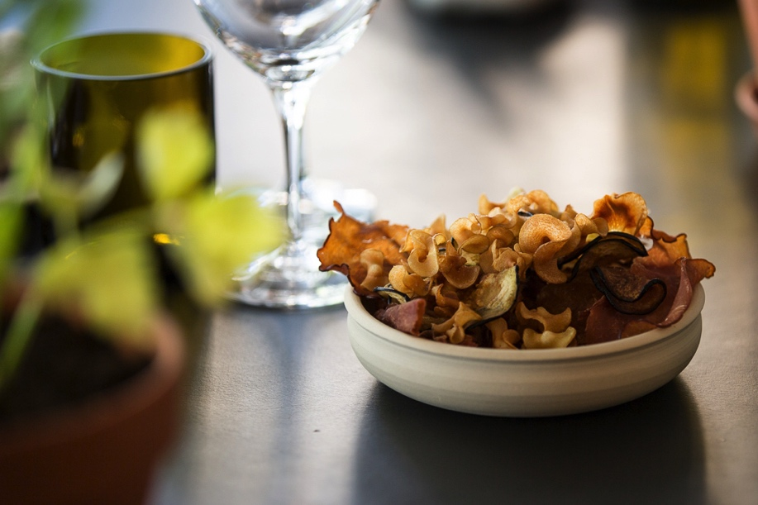
WHAT IS #ReTaste?
Notes:
Whats going on over at the kitchen… - Intro Ekman
#retaste is a movement
#retaste is a verb – you DO IT
Carry it forward

Slide 6
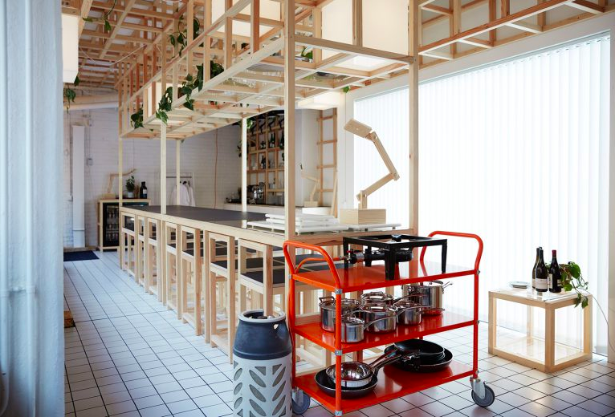
Notes:
Temporary
Restaurant
#1 – DELICIOUS
Set an example – show case what can be done
Aim: change perception, reimagine what is flavorful, what can cook well, what we SHOULD use.
Challenge chefs, challenge the public. See waste as an opportunity, not a problem

Slide 7
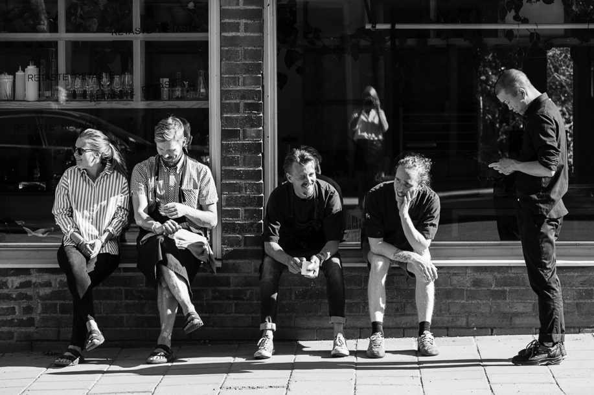
Who is #ReTaste?
Notes:
Pauls Kok + Retired Hen

Slide 8


HOW?
Notes:
Monday and Tuesday
Twice a week pick ups
Mo 1 x electrolux / coop + willys
Mo 2 – 4 : COOP. 1 x large store + next door.
Partners – Electrolux.
Not just food – FOH too

Slide 9
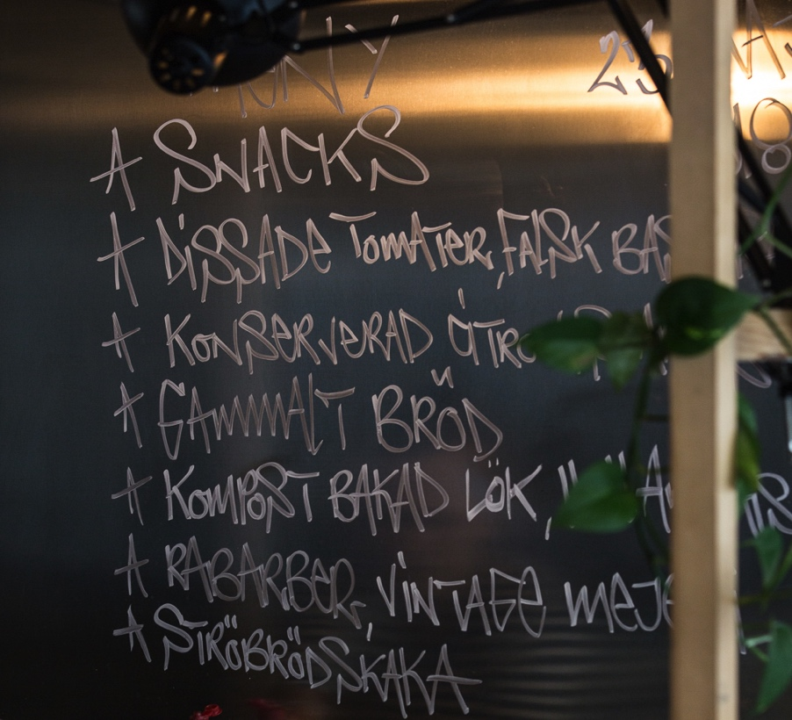
Menu Development
Notes:
Menu process:
Framework of dishes to create a menu.
EACH WEEK:
Selection : Snacks - using imagination
1 x fermented & pickled: long lasting. Sriracha still being used. Never wastes. Keeps going
1 x upgraded bread. Pasta / pizza
1 x master stock dish – beverage incorporated into the dish
1 x main with whole piece veg
1 x mature fruits : pudding. Boxes of fruit story. Peaches / strawberries / tomatoes PACKAGING CONVERSATION
1 x socker kocka

Slide 10
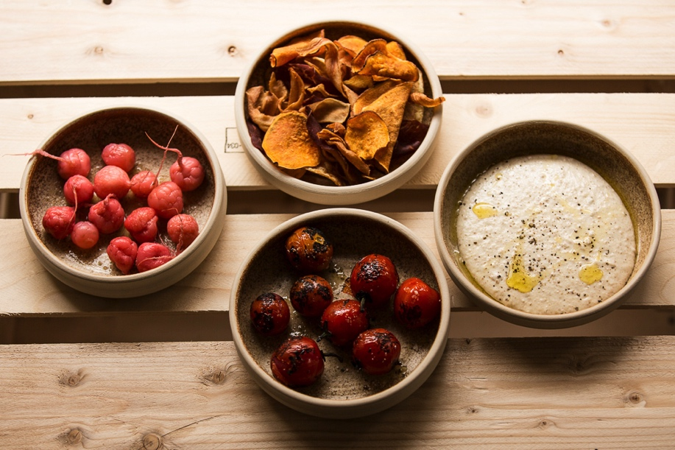
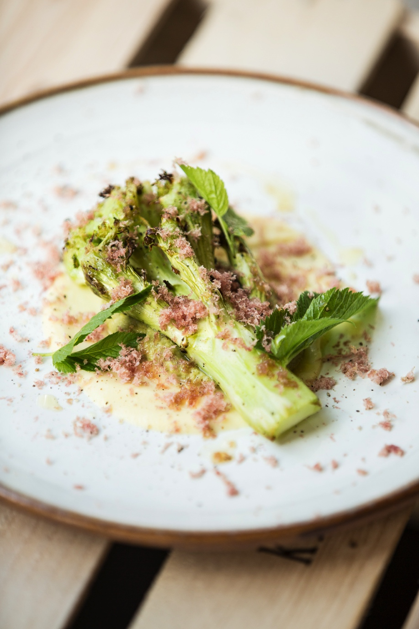
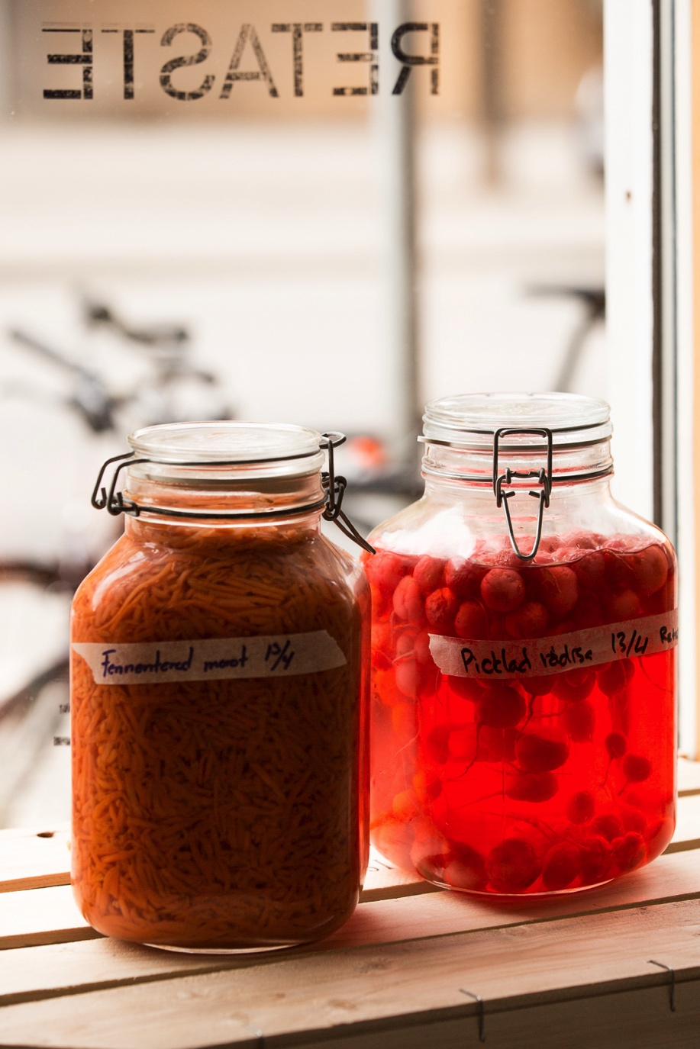
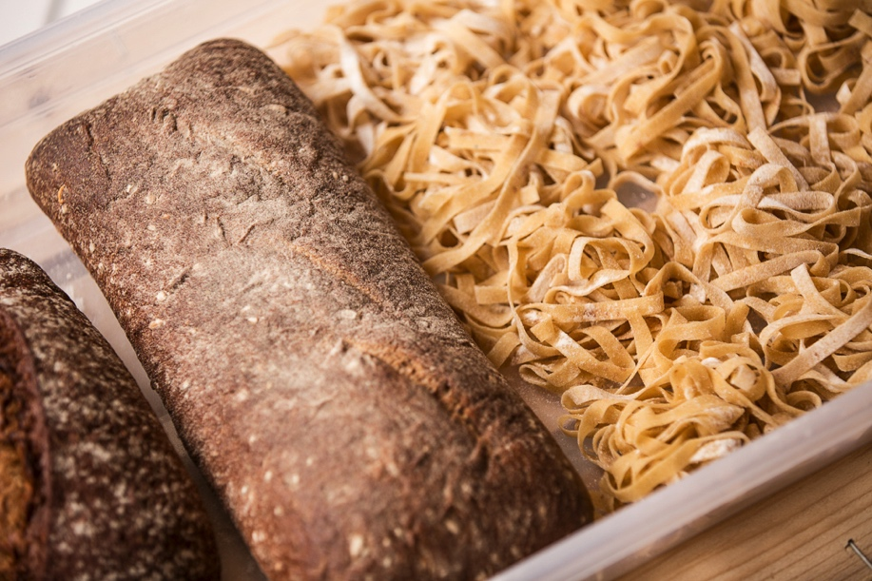
Dinner is served…
Notes:
DISH EXAMPLE
Snacks
Single large piece veg
Ferment / pickle
Upgraded bread
Pudding

Slide 11
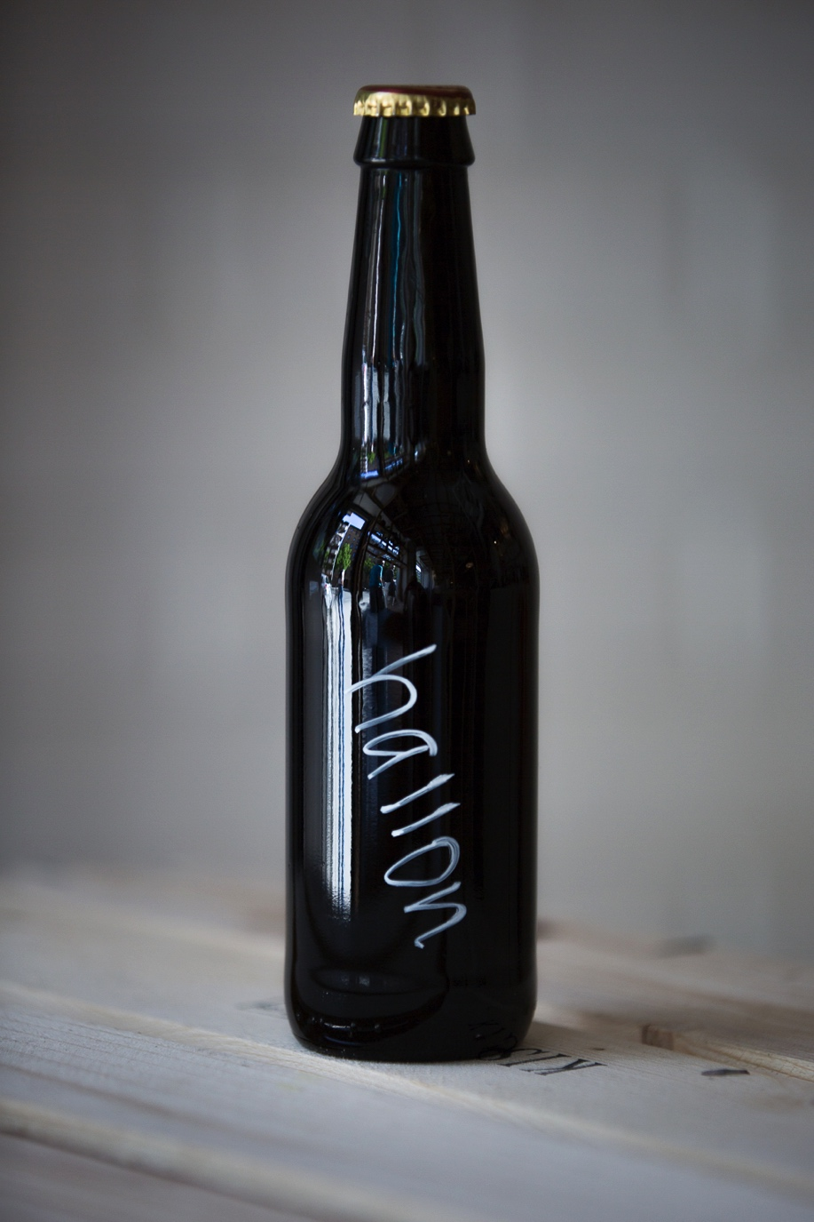
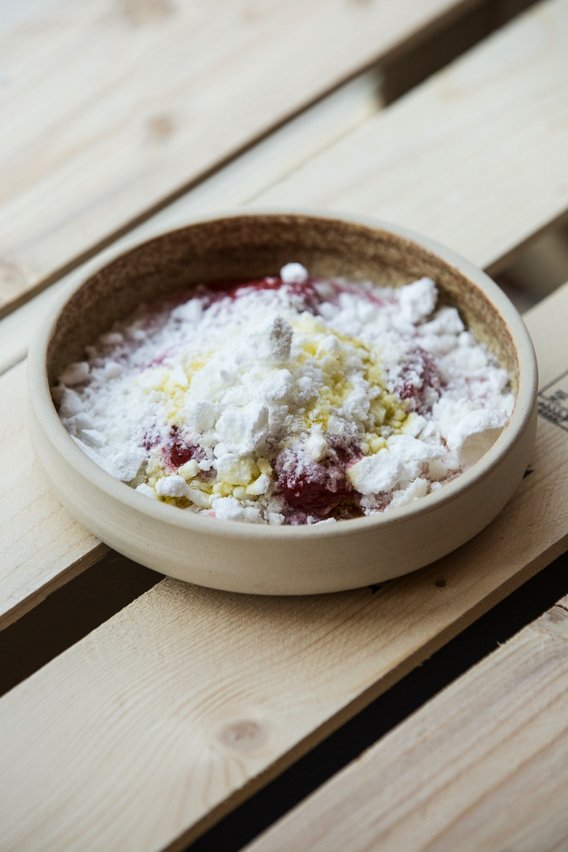
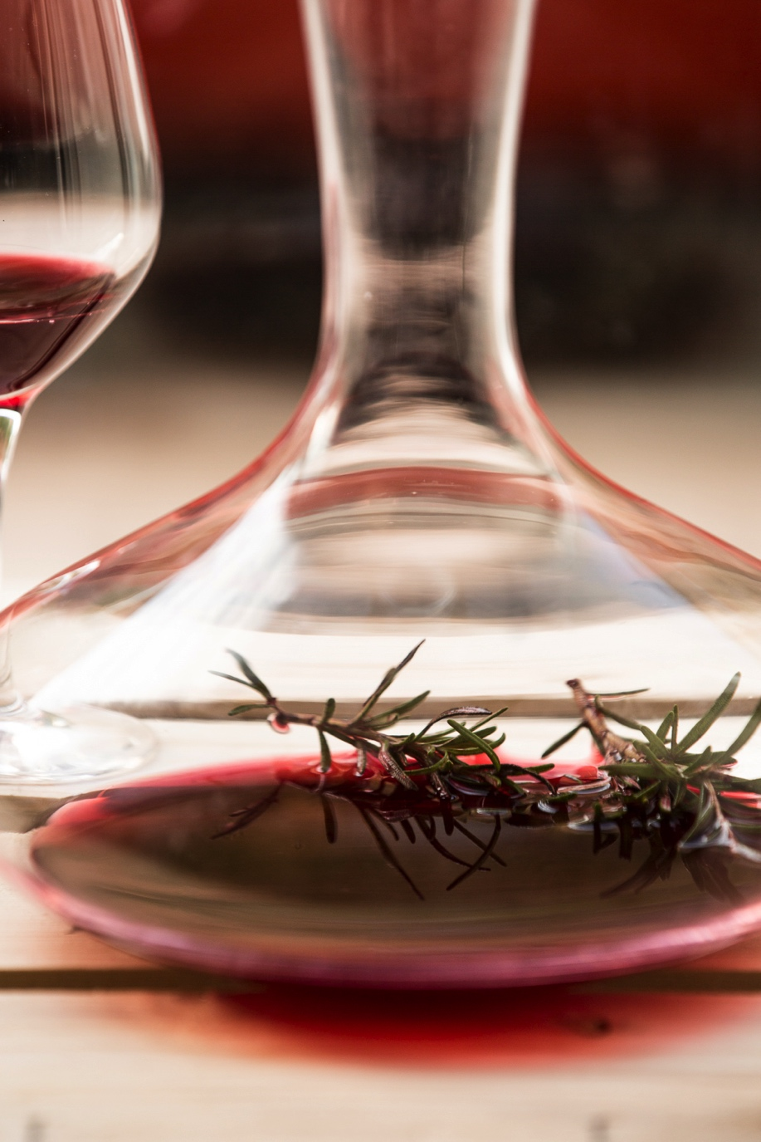
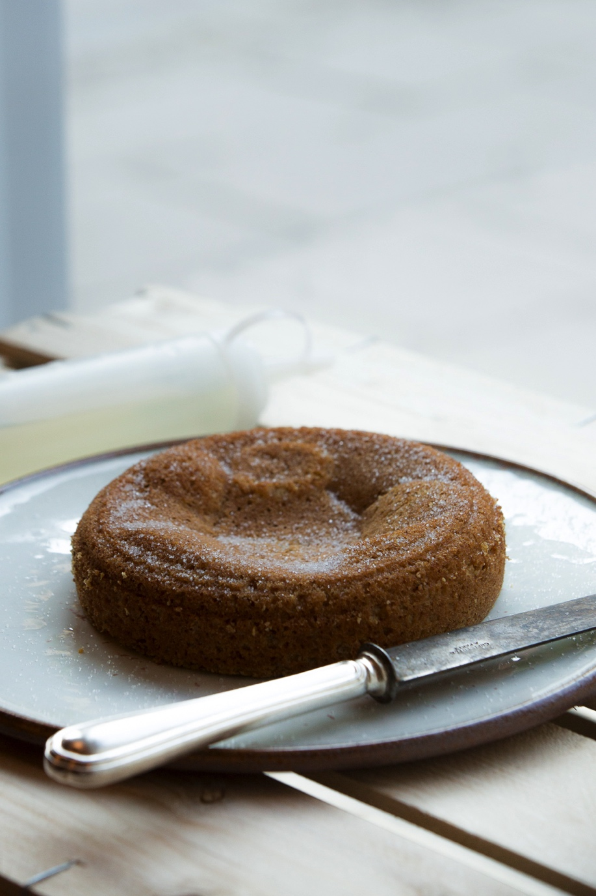

Slide 12
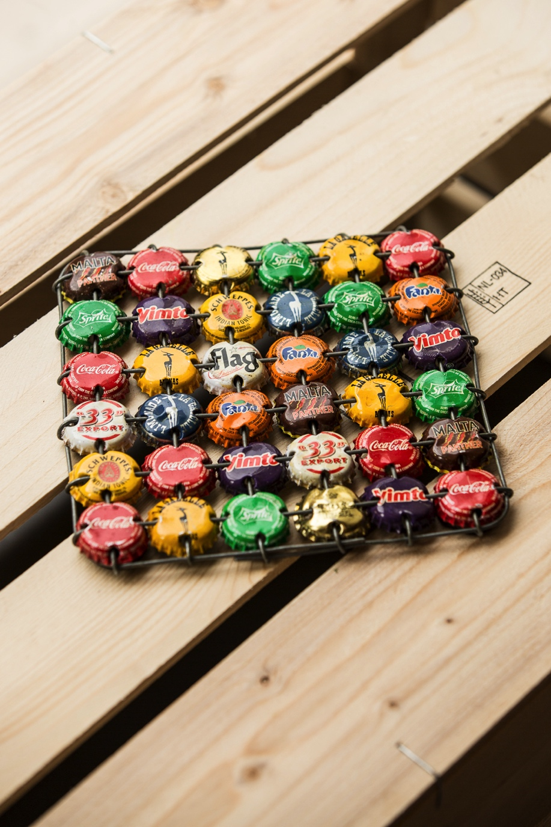
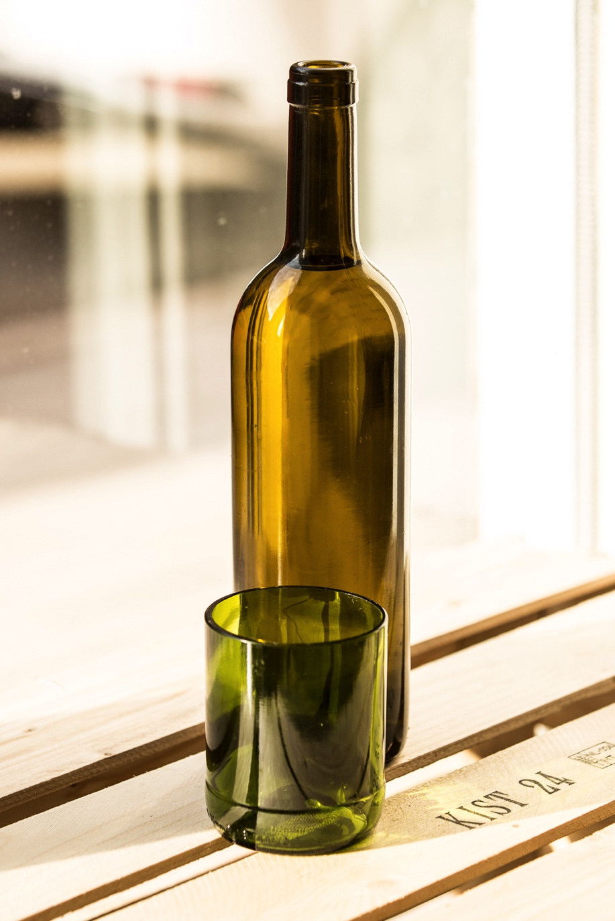
Not just the kitchen
Notes:
ReTaste – whole experience.
FOH
Wine bottles. Heat mat. Plates

Slide 13
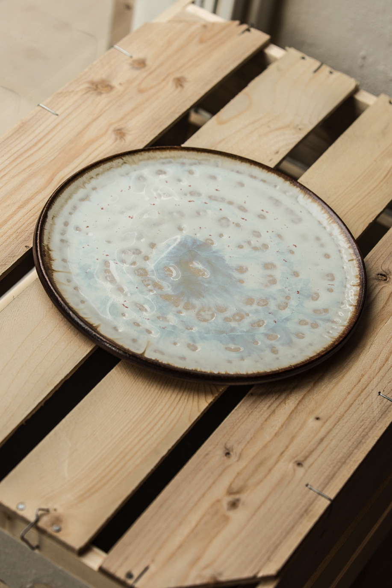
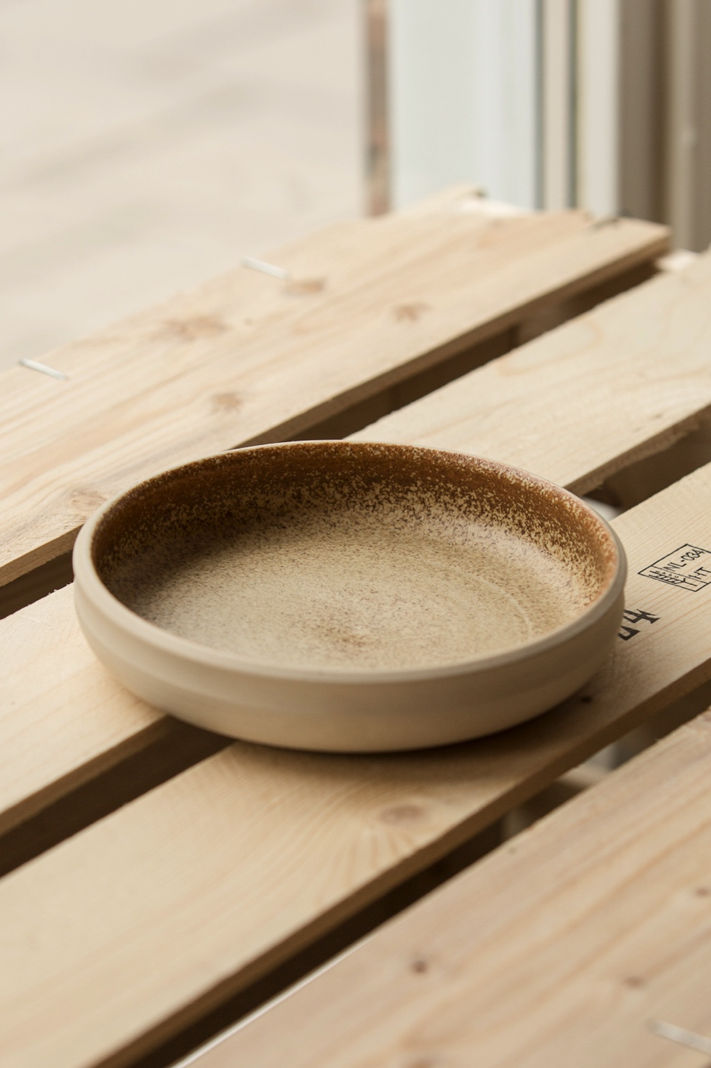

Slide 14
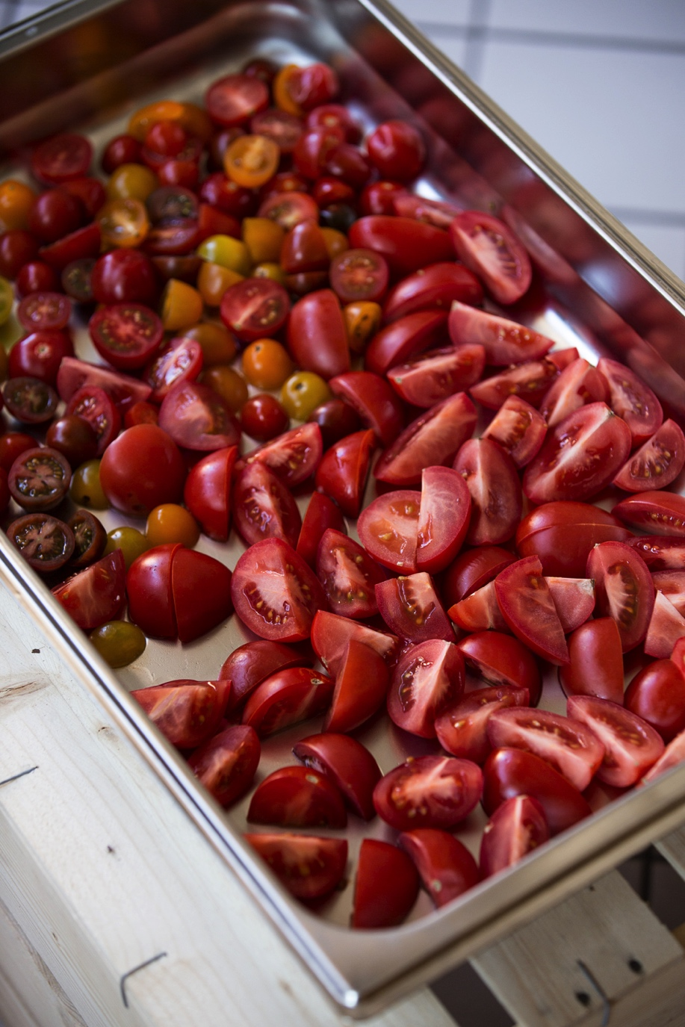
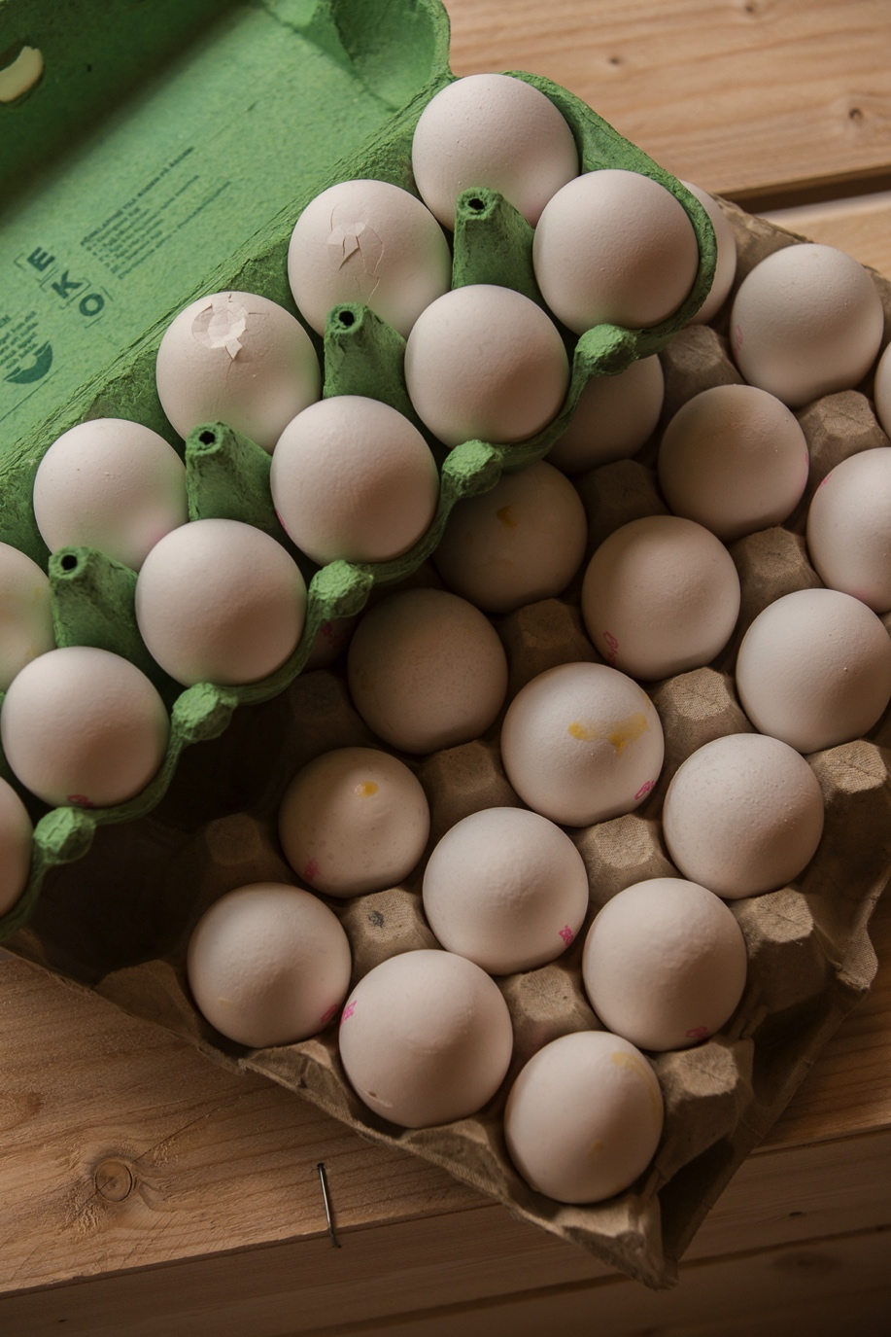
Challenges
Notes:
PACKAGING and soft veg
STAFF: sorting process – not all premium. Takes time. Cost implications
Plastics and containers – doesn’t come in the same style as regular restaurant produce delivery
Ugly fruit – tomato lemonade / tomato sauce..
Cant be zero waste – some things are just beyond.
We compost / bio gas. Not landfill.
Legal barriers – Tight EHO and food safety in Sweden.
Some products cant be reimagined. Mainly meat and fish
BB / Consume by…
BB is fine : use same day when meat / fish.
Not everything is rescued – pantry needs to be in place in order to allow this produce to be reimagined – vinegar / salt / sugar / spices / butter etc.
95% is actual food waste
KEY: MUST TASTE GOOD.
You cant sell sustainability if it doesn’t taste great. No one will get involved.

Slide 15
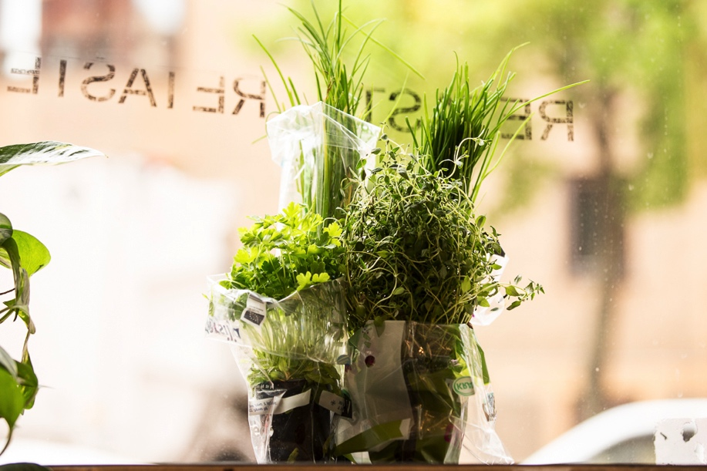
Learnings + conclusions
Notes:
There is still value in products
Need to re-programme your brain as a chef.
Don’t just see the obvious. Yellowed herbs can still pack flavour, soft tomatoes are delicious
Sometimes old fruits are more flavourful and work better – don’t disregard them as a great product.
food waste is a business topic as well and can drive customers through creative marketing
Pay per kilo to remove old produce.
Produce is free as it is a non-profit.
Finance is till important – we have salaries to pay. 2 x 40 hr chefs + Matilda at 24hr. Needs
Long term it not viable
2000 square meter project.
Niklas.

Slide 16
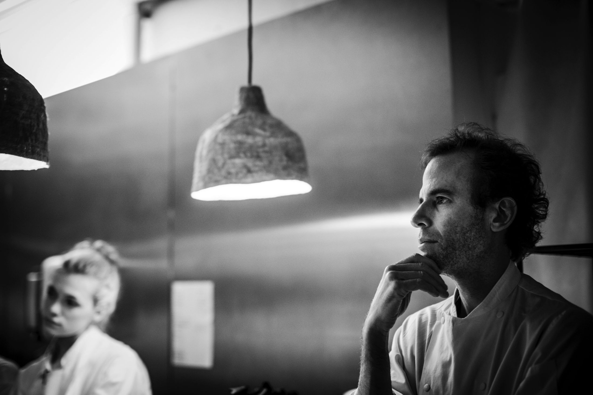
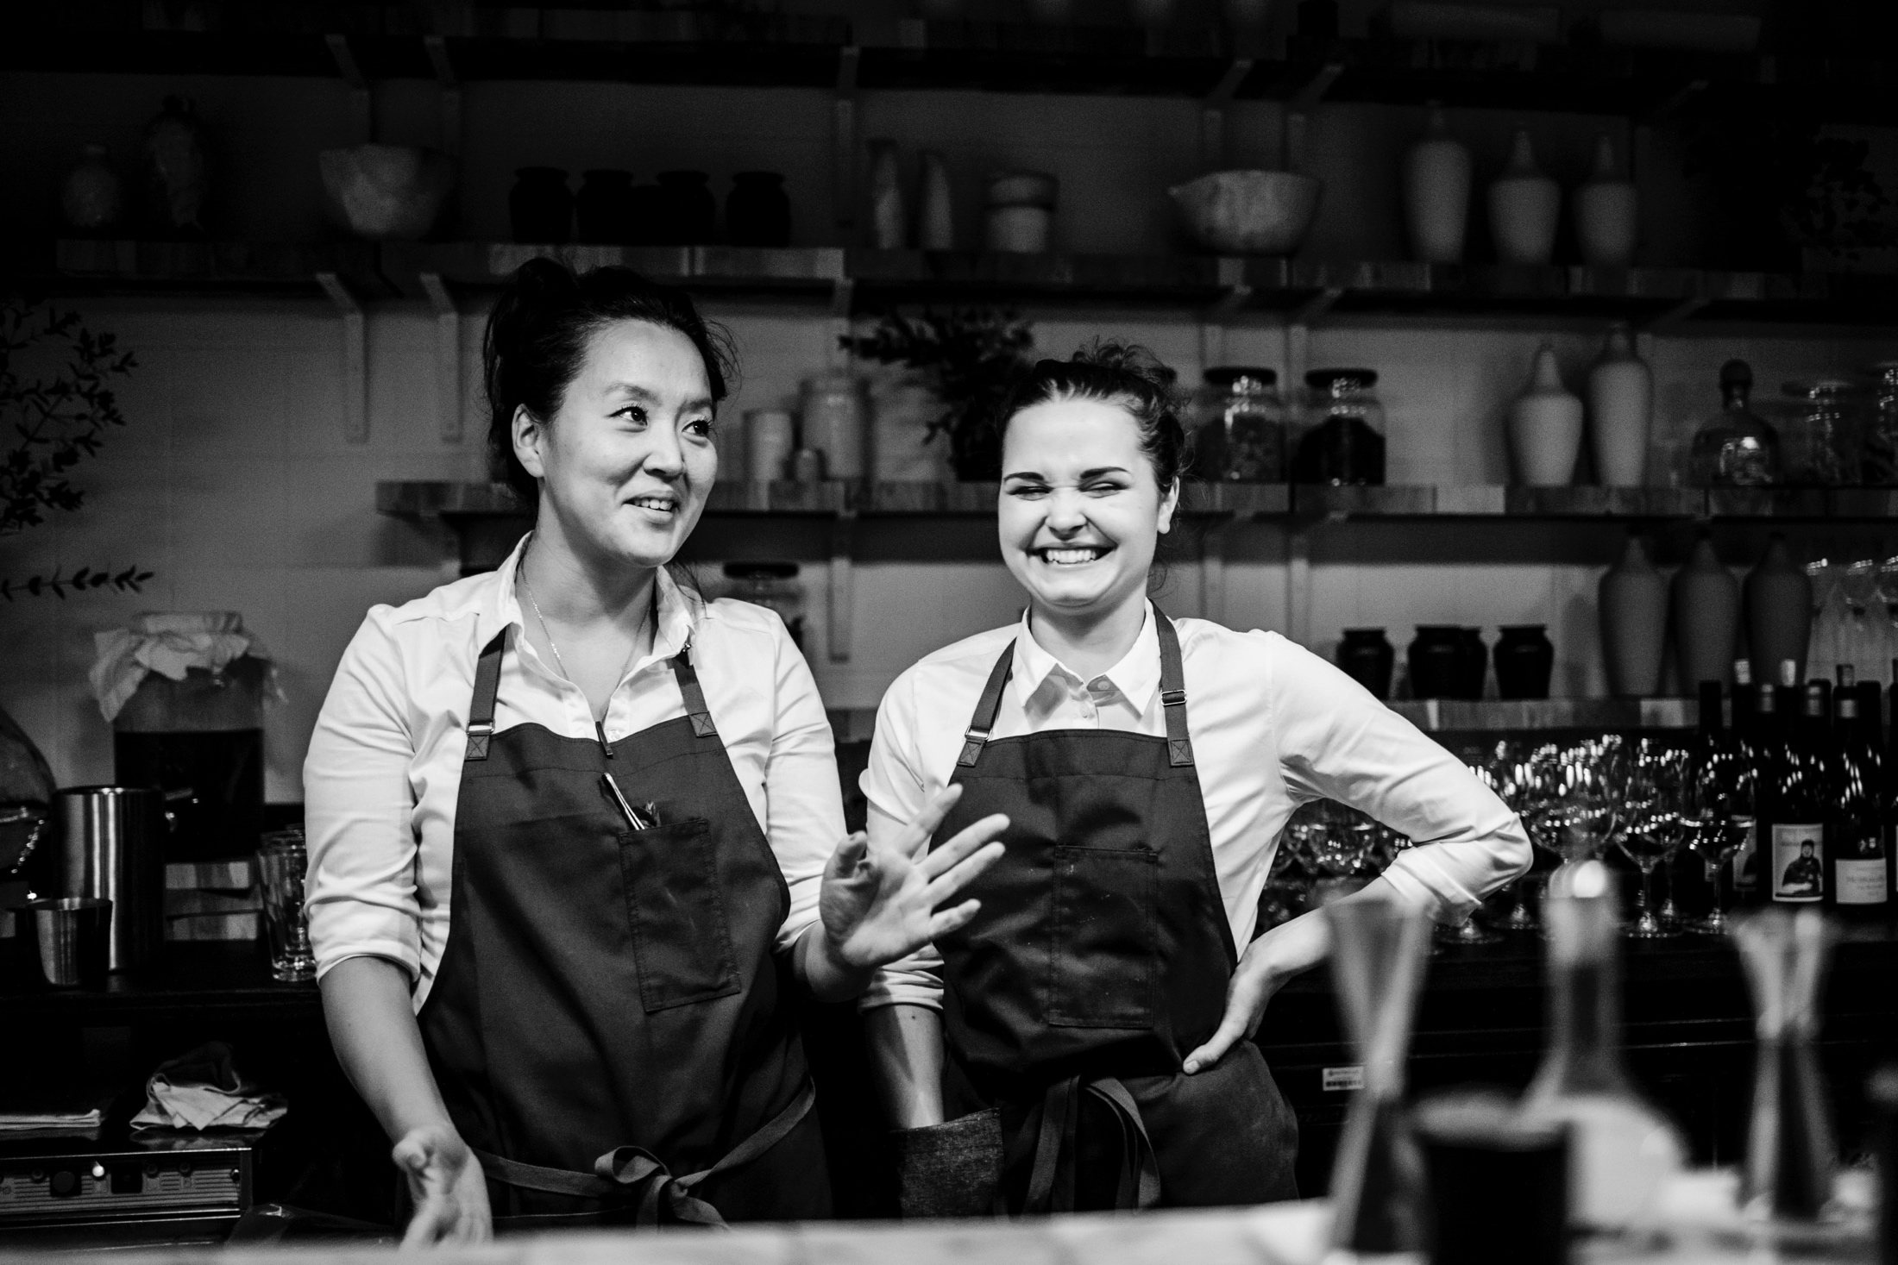
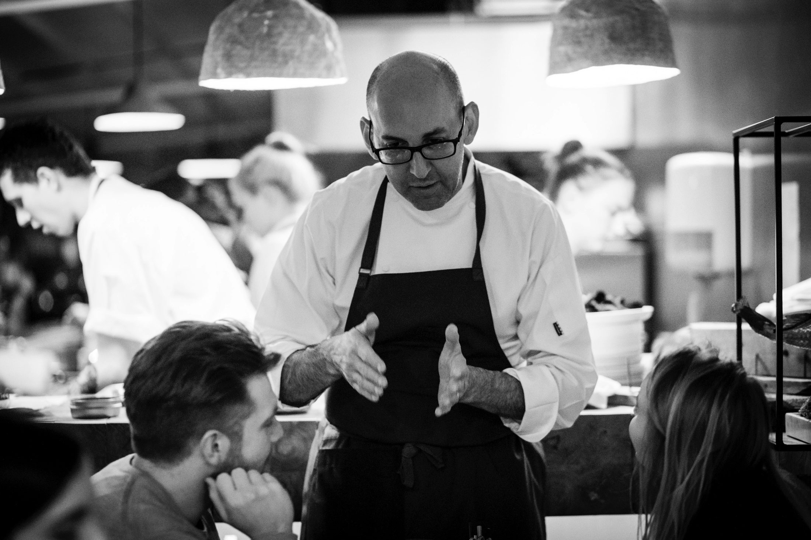
The story comes from
everywhere.
We must take every
opportunity to
spread the word.
Notes:
Its not just the kitchen.

Slide 17
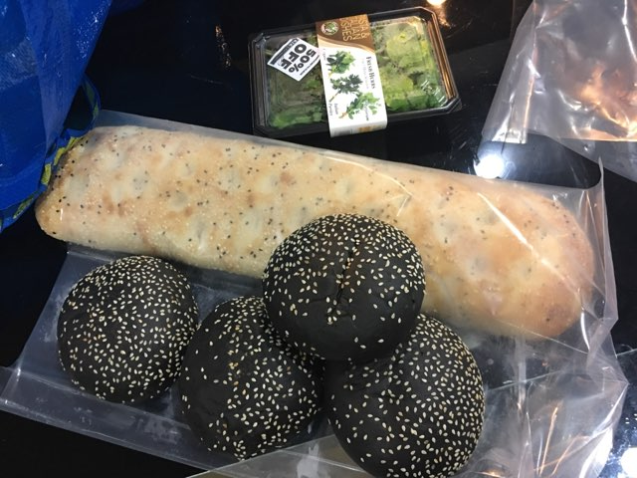
Todays waste…

Slide 18
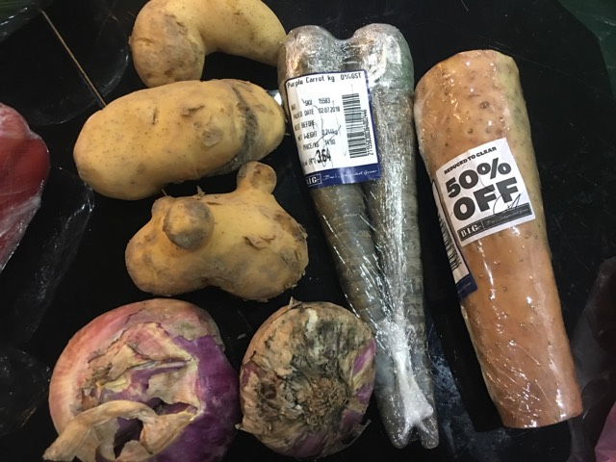
Todays waste…

Slide 19
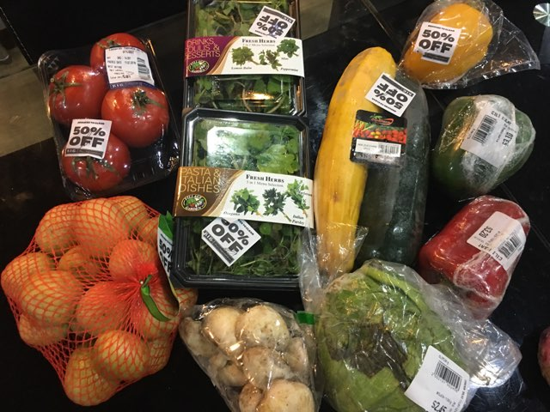
Todays waste…

Slide 20
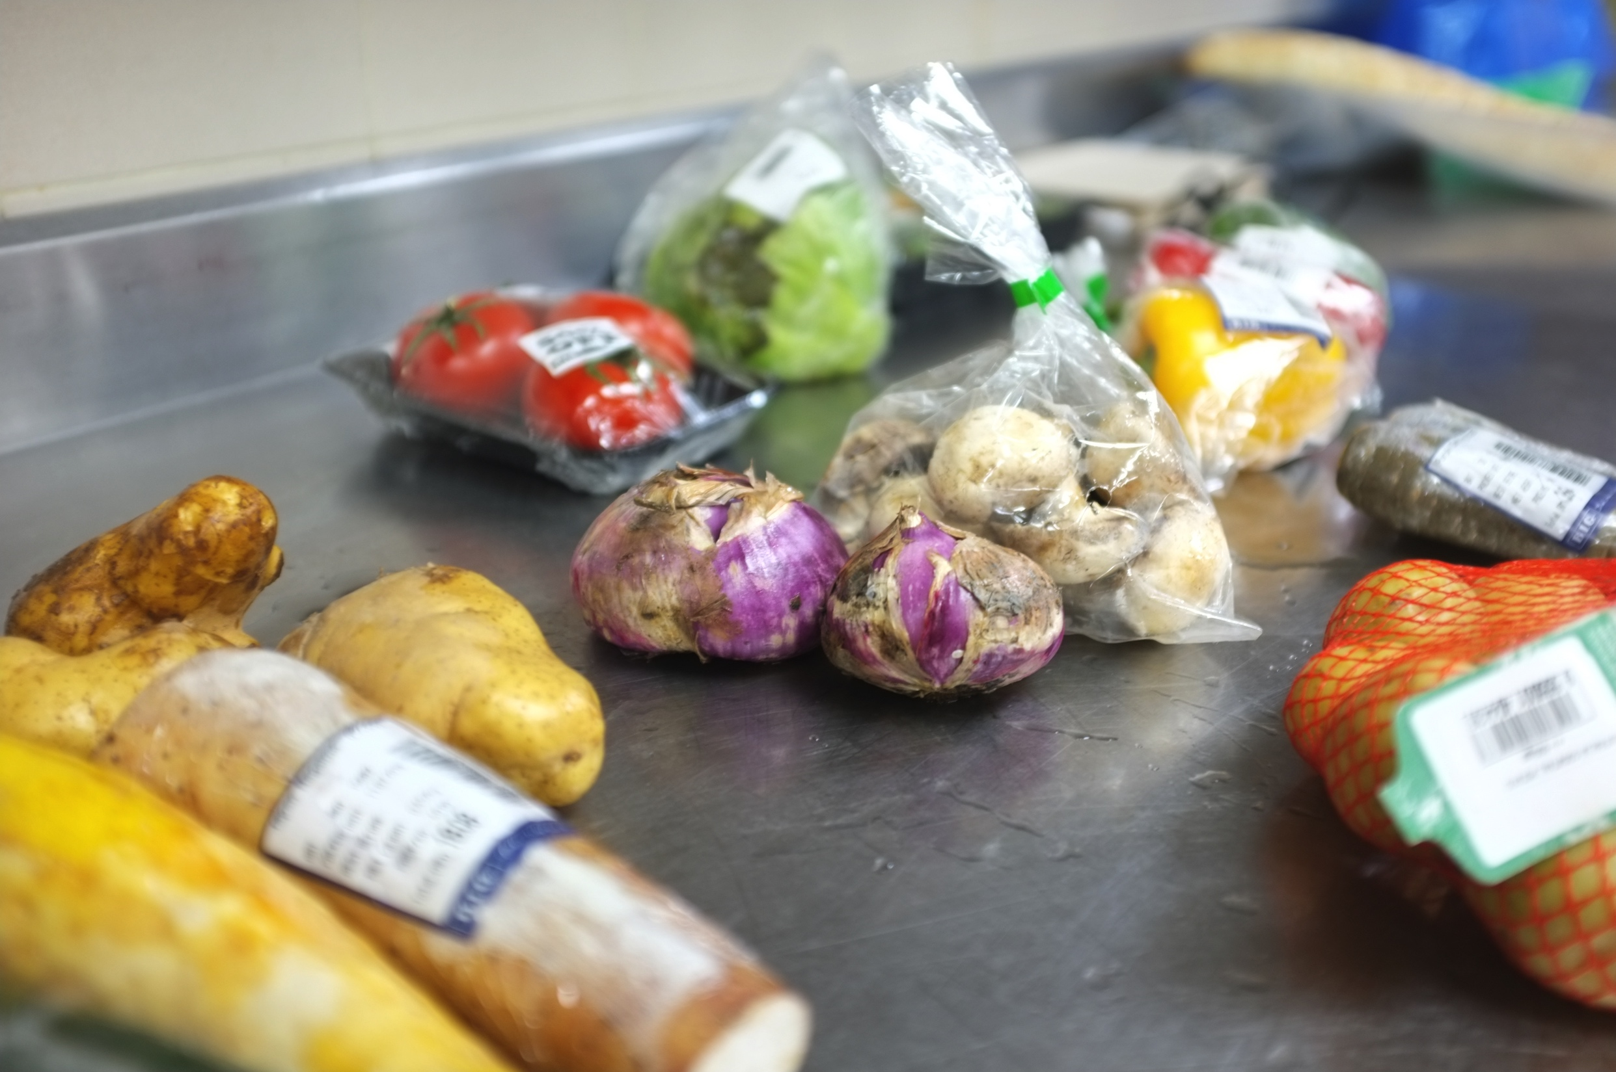
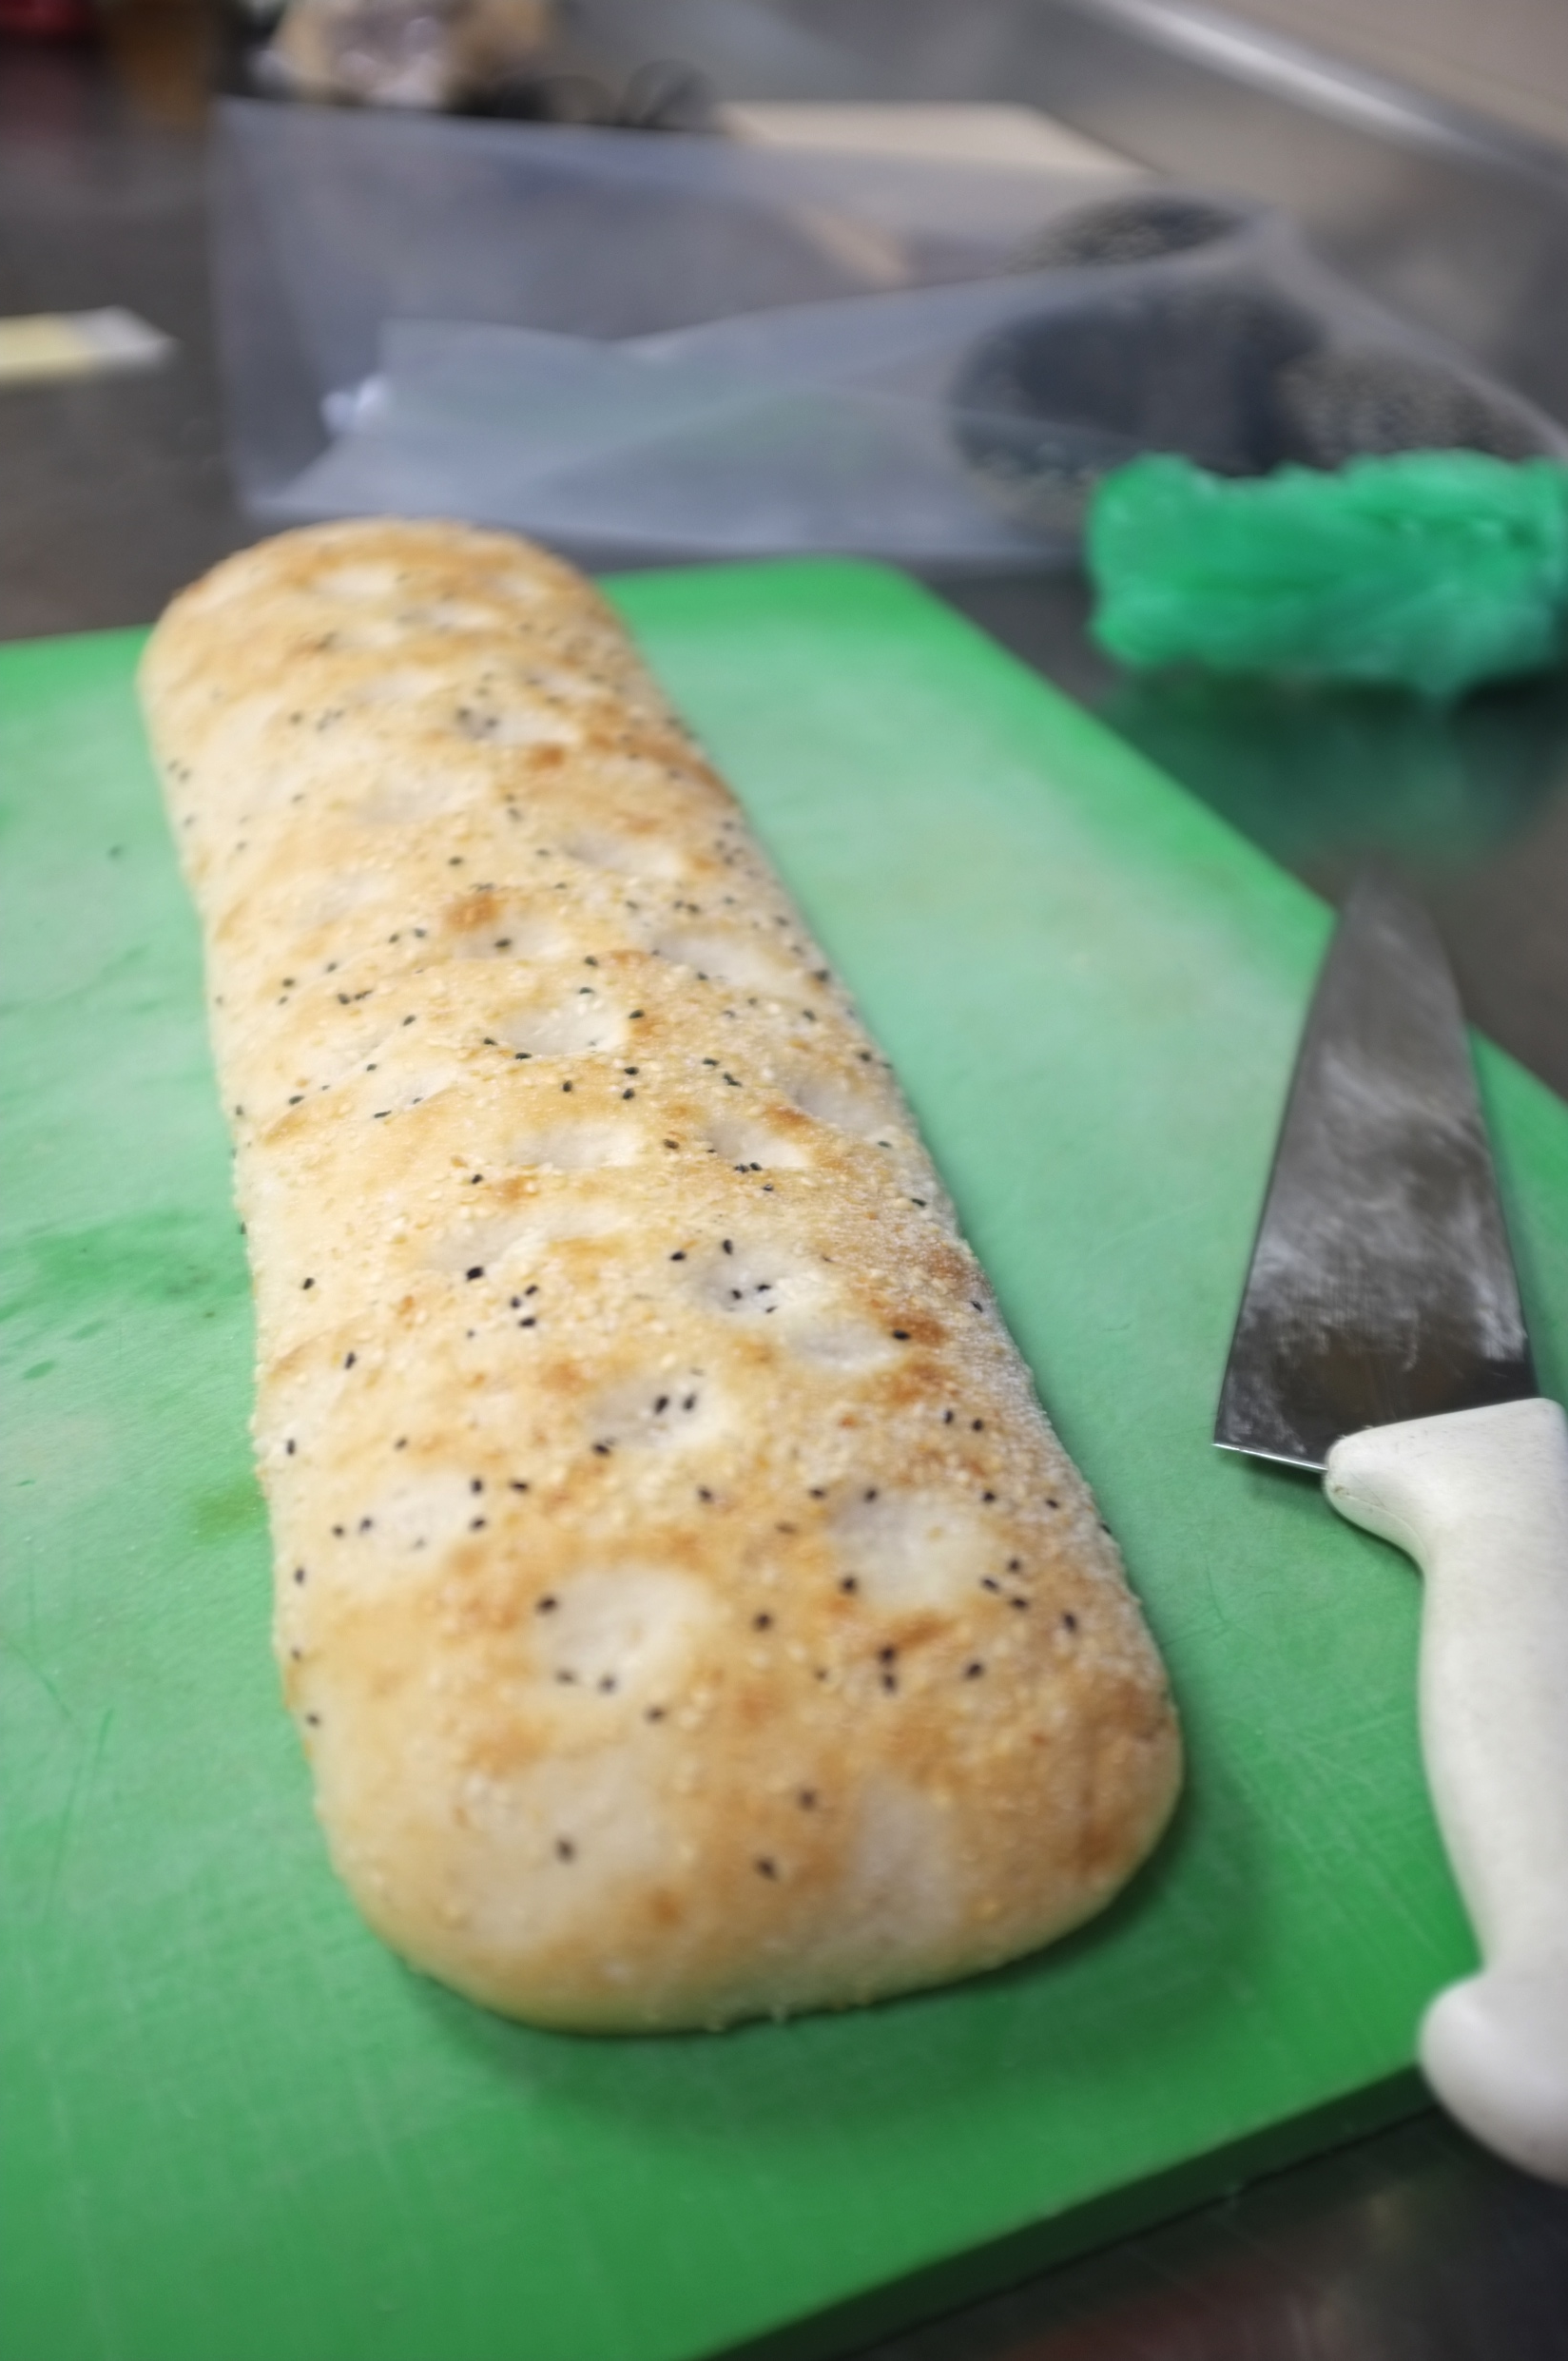
Todays waste…

Slide 21
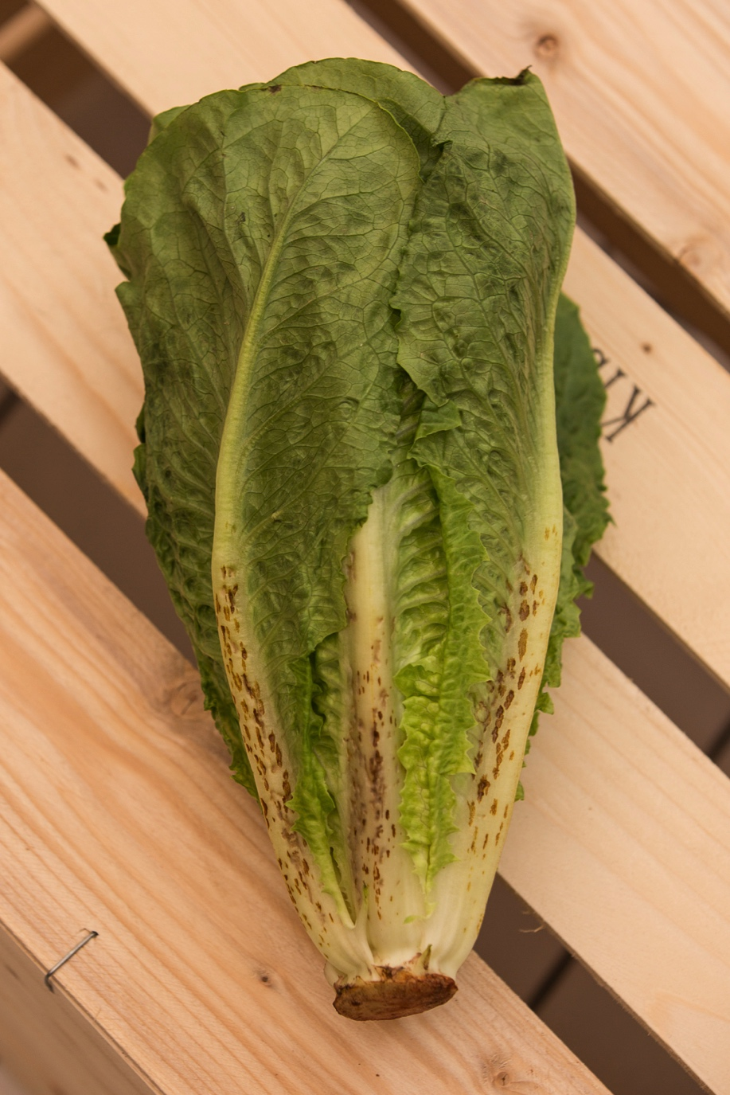
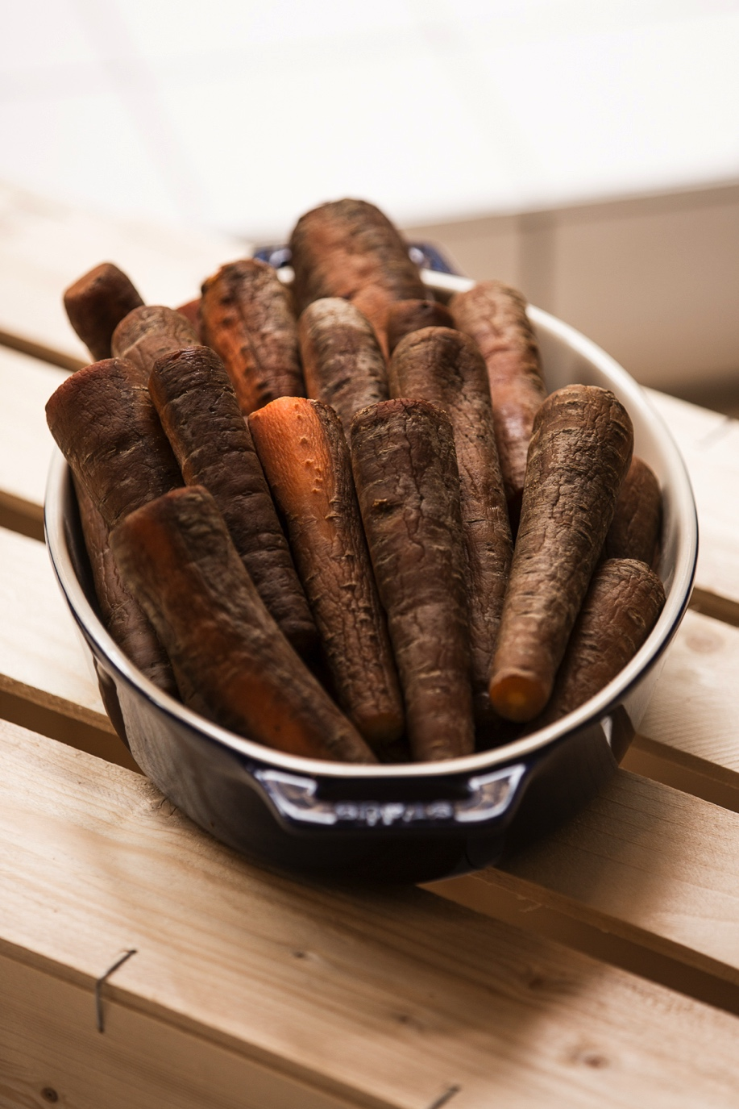
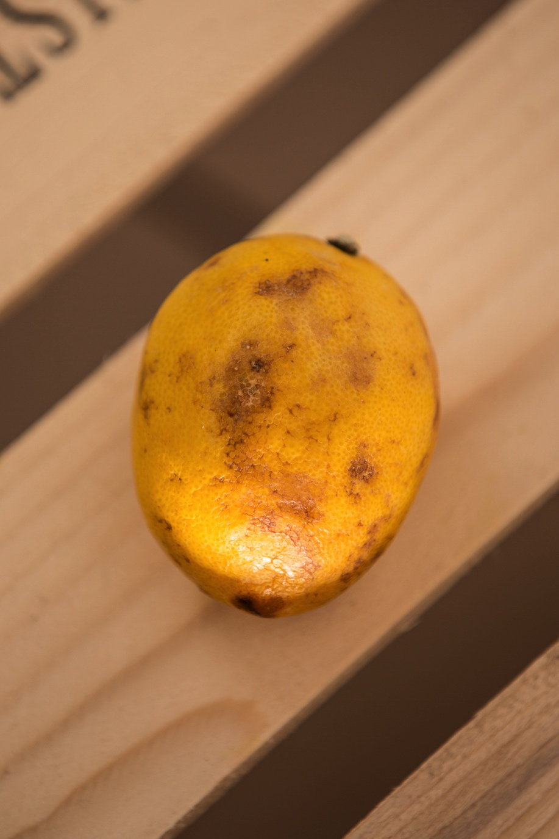
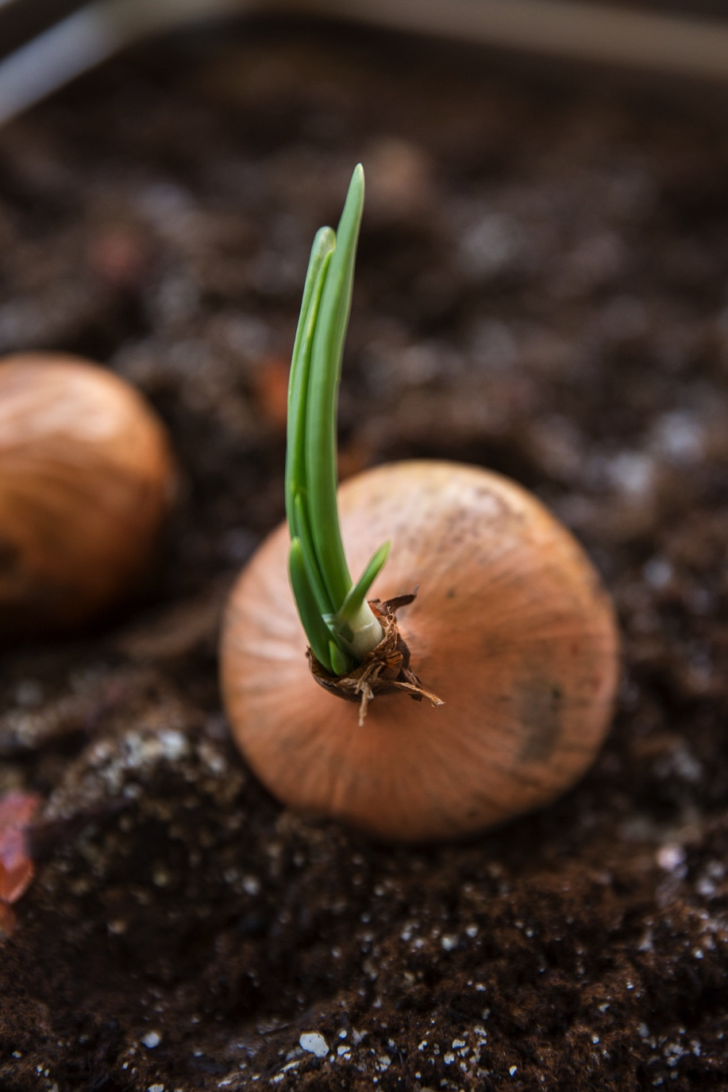
“Food waste is the failure of the imagination”
Douglas McMaster
Silo UK
#ReTaste Thank you.

