Slide 1
Trends and Innovation in the world of True Aussie Red Meat
Traceability . Quality . Safe . Sustainability
Brought to you by :
Presented by :
Mark Normoyle, Executive Chef

Slide 2
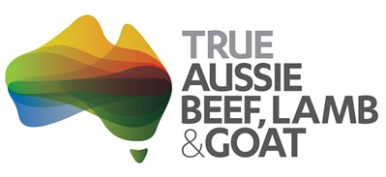
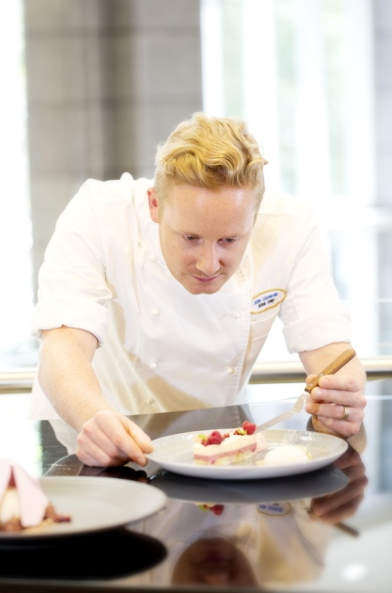
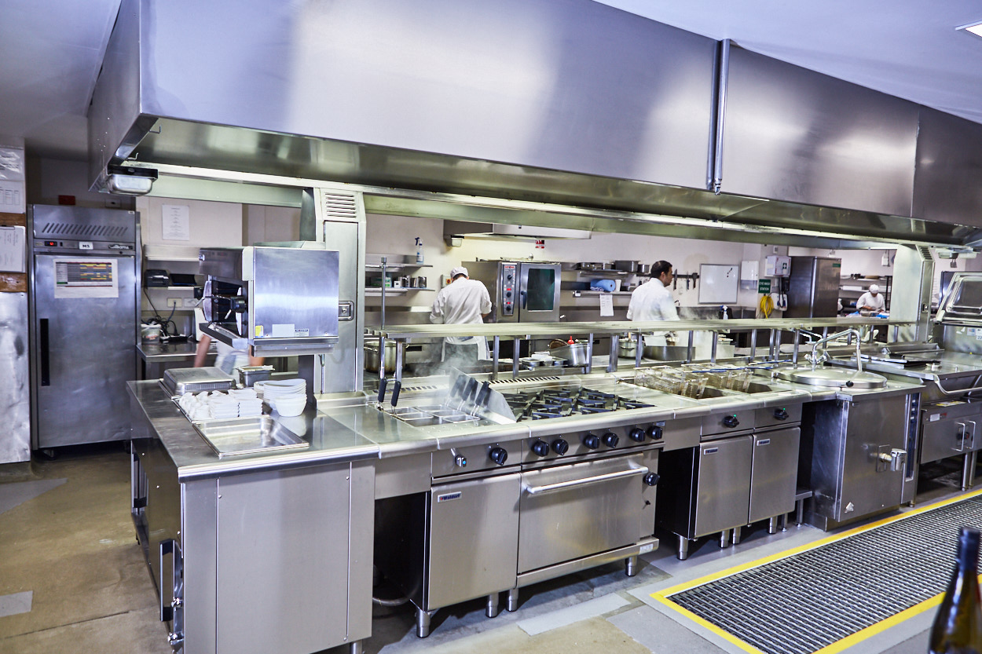
RACV City Club, Melbourne, Australia

Slide 3
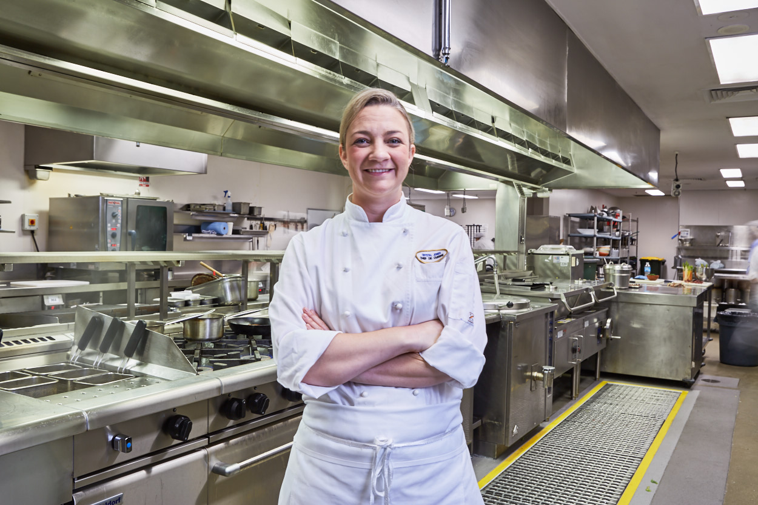
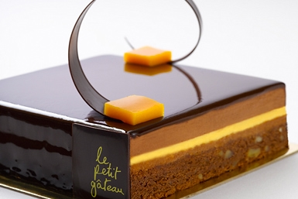
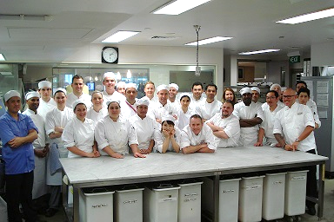
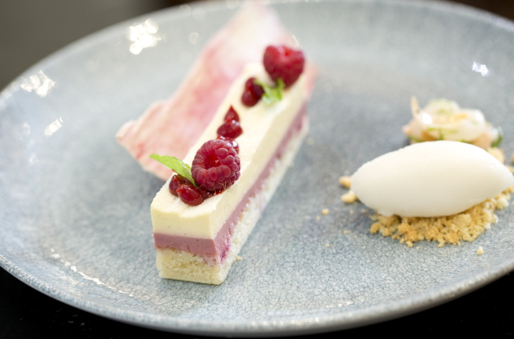

Slide 4
Supporting our vibrant Industry

Slide 5
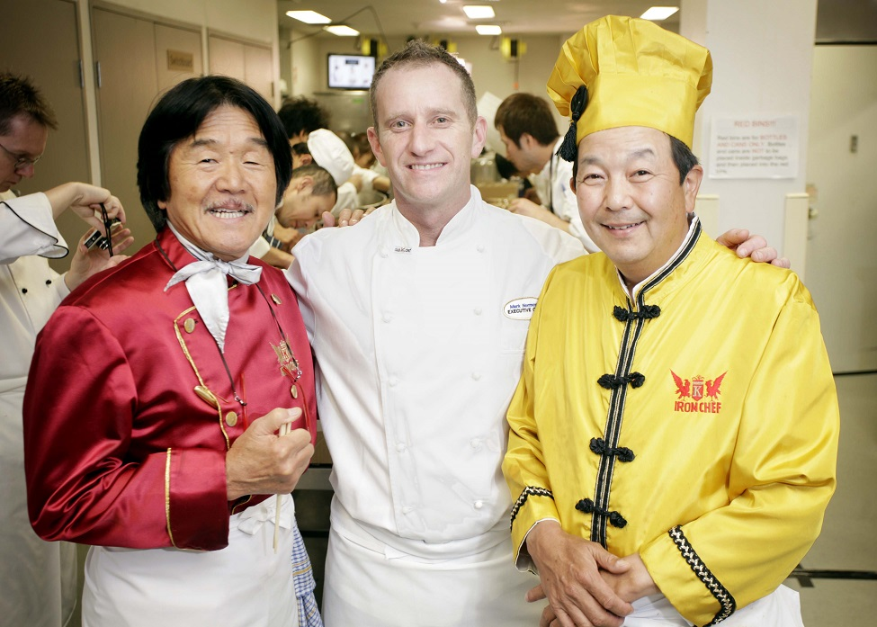
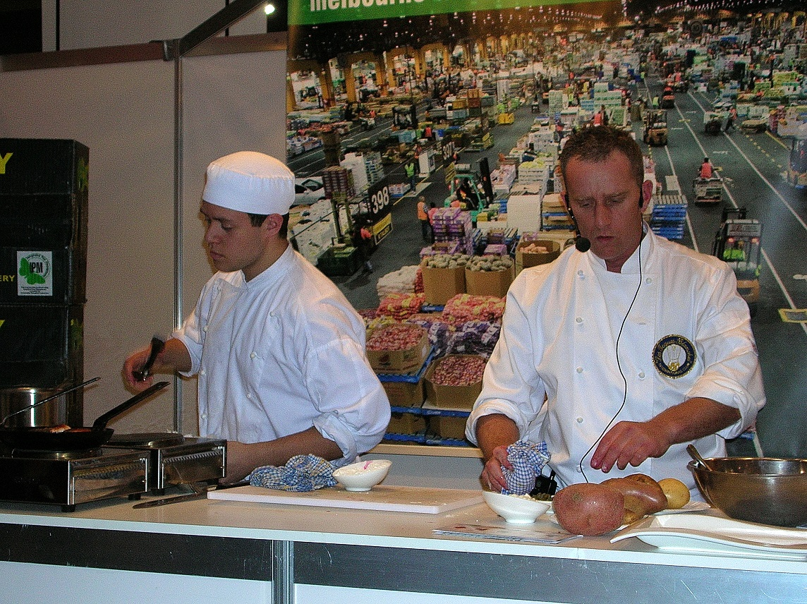
Industry events

Slide 6
Meet the true blue Aussie farming family, the Mc Arthurs. 4th generation cattle farmers Mystery Park farm, 300 km from Rockhampton on the central coast of north Queensland

Slide 7
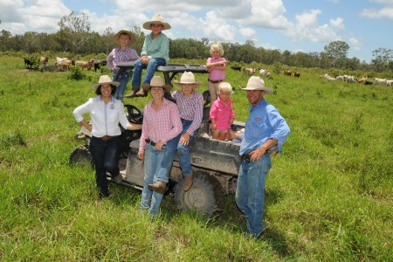
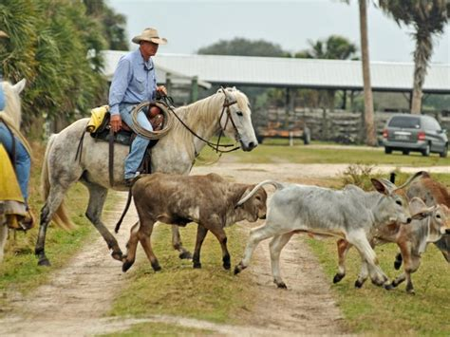
12,000 hectare property, run by the family of 8

Slide 8
Australian quality assurance systems supporting the farm 1. Property Identification codes – PIC 2. National livestock identification system - NLIS 3. LPA National vendor declaration and way bill 4. National sales yard quality assurance program - NSQA 5. Meat processing practise guidelines 6 Processing quality systems

Slide 9
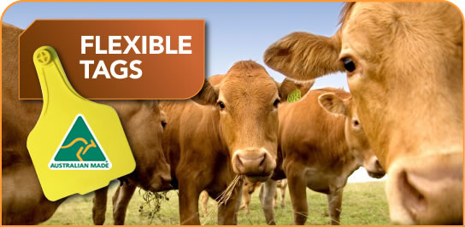

Slide 10
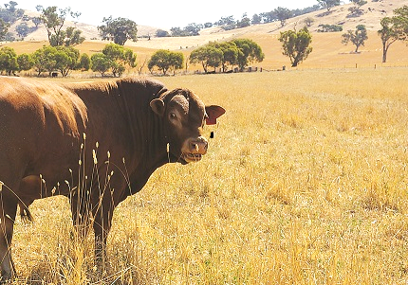
Other key systems in the quality assurance chain 1.National feedlot accreditation scheme – NFAS 2.Meat processing practises and guidelines 3.Processing quality control

Slide 11
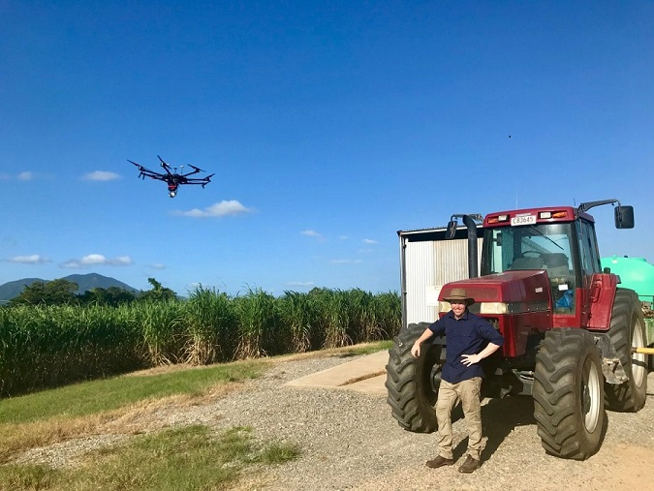
Innovation at the farm gate

Slide 12
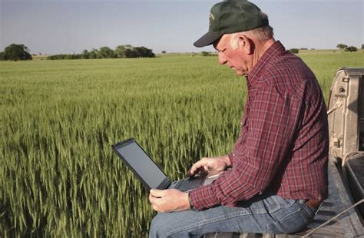
The advent of digitised agriculture means farmers have the ability to gain control over their farms in ways they never had before.

Slide 13
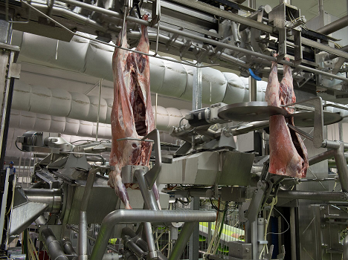
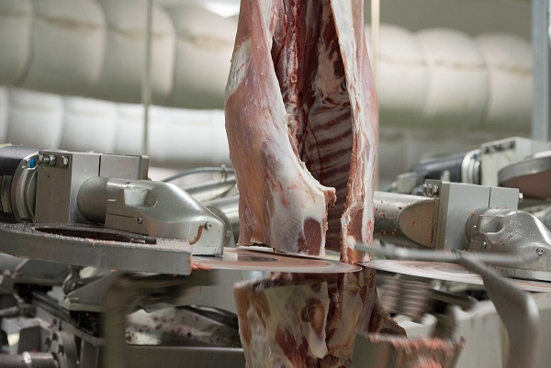
Innovation at the processing plant

Slide 14
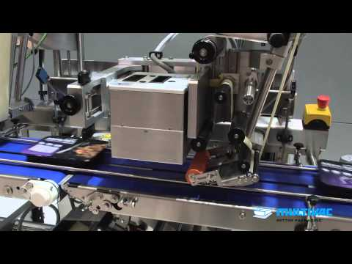
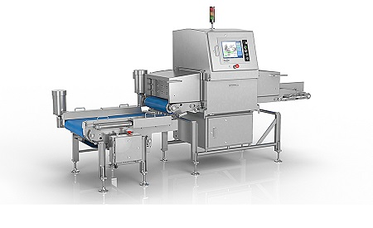
Innovation at the processing plant

Slide 15
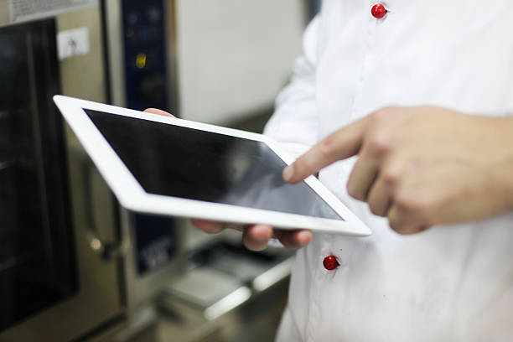
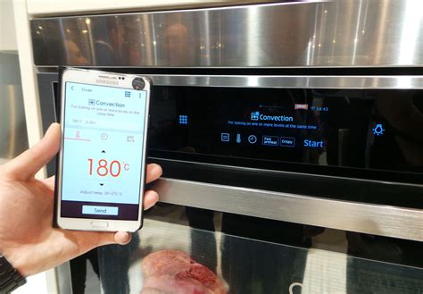
Innovation in the kitchen

Slide 16
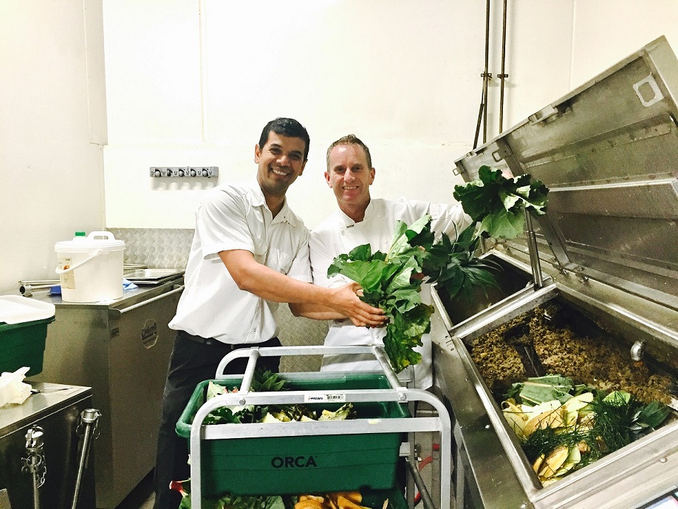
Innovation in sustainability

Slide 17
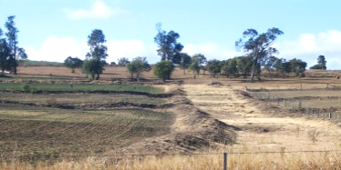
Sustainability on the farm Contour banks, earthen structures placed across and at intervals down a slope so as to intercept and divert run-off water.

Slide 18
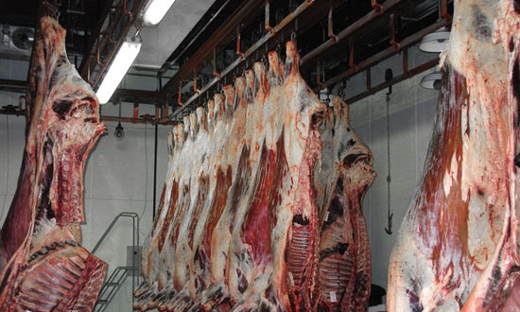
Sustainability in meat processing

Slide 19
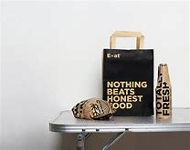
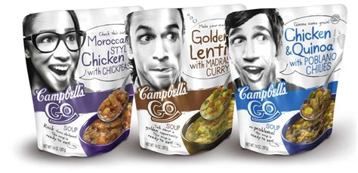
Our customers for the future

Slide 20
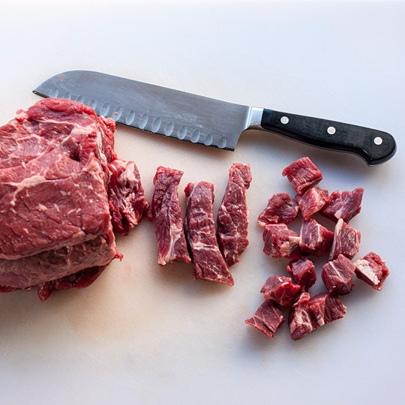
Non loin cuts , the trend continues

Slide 21
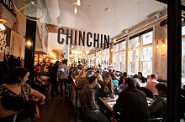
What’s hot-casual trendy dining

Slide 22
Thanks for attending and keep up the great support of Aussie beef, lamb & goatmeat ! http://www.beefandlamb.com.au /meatandlivestockaustralia

